Slide 1
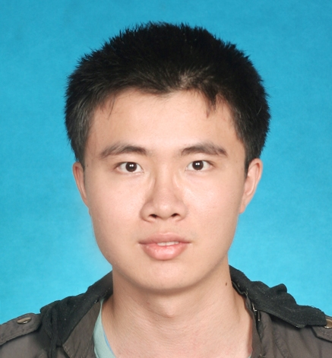
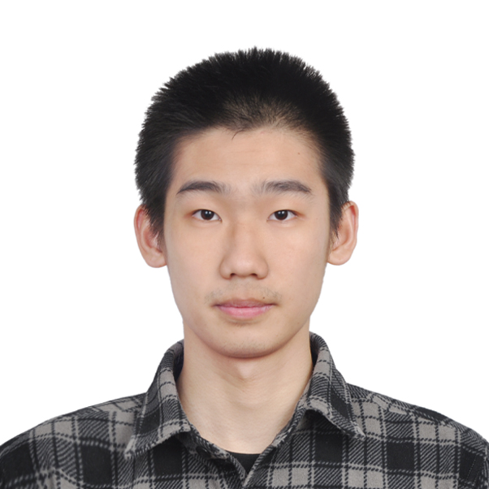


Continuously Indexed Domain Adaptation
Hao Wang*
Hao He*
Dina Katabi
ICML 2020 Oral
(* indicates equal contribution)

Slide 2



Domain Adaptation
One to One
Source Domain
Target Domain
$X_{s}$and${ Y}_{s}$
$$X_{t}$$
Predict${ Y}_{t}$
Many to One
Multiple Source Domains
Single Target Domain
Many to Many
Multiple Source Domains
Multiple Target Domains

Slide 3

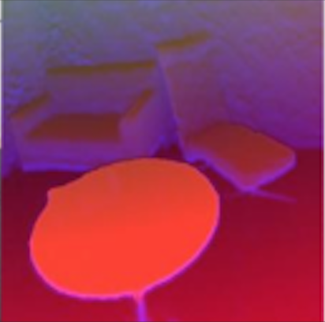
Problem: Current Domain Adaptation is Categorical
Category 1
Category 2
MNIST
SVHN
RGB
Depth
But many real problem involves continuous domains!

Slide 4
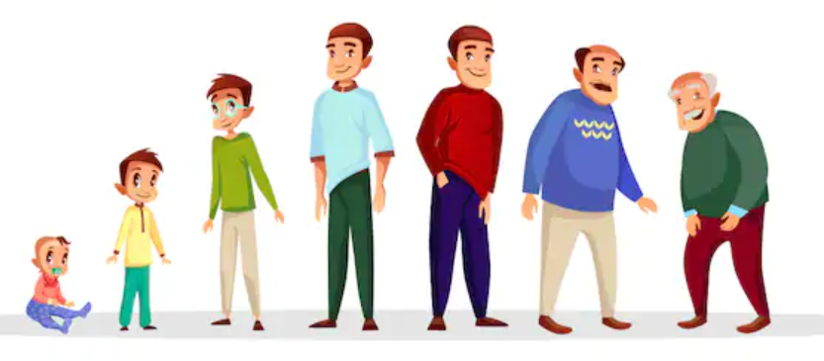
Medical Applications Require Adaptation Across Age Which is Continuous
Age
Young
Old

Slide 5




Self-Driving Car Applications Require Adaptation Across Time Which is Continuous
Morning
Night
Time

Slide 6
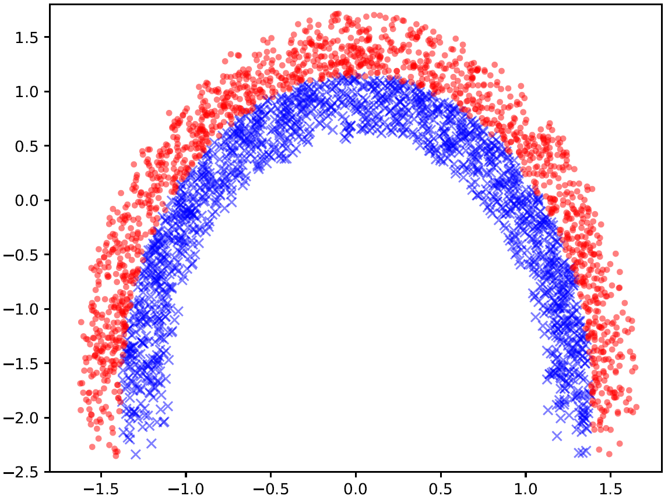
Example of
Continuously Indexed Domain Adaptation Problems
Domain 15
Target:
Domain 7 to 30
Domain 30
Domain 2
Domain 1
Source:
Domain 1 to 6
Setup:
30 continuously indexed domains
Ground-truth labels (red and blue)
Task:
Source -> Target

Slide 7
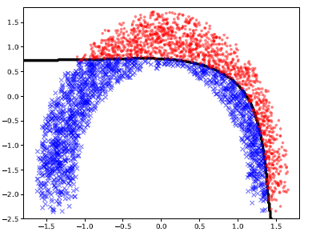
Performance of Categorical DA
Target
Source
Results
ADDA: Adversarial Discriminative Domain Adaptation (Tzeng, Eric, et al., CVPR 2017)

Slide 8
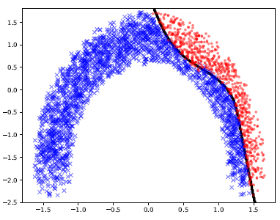
Performance of Categorical DA
Target 2
Target 1
Target 3
How should we perform
continuous domain adaptation?
Source
Results
DANN: Domain-Adversarial Training of Neural Networks (Ganin, Yaroslav, et al., JMLR 2016)

Slide 9
Why Categorical Domain Adaptation Fails
Target:
domain 15
Distant
Cannot capture how the data distribution continuously changes along with the domain index
Close
Target:
domain 8
Source:
domain 1

Slide 10
Why Categorial Domain Adaptation Fails
Target:
domain 15
Target:
domain 8
Source:
domain 1

Slide 11
Solution: Leverage the Domain Index
Target:
domain 15
15
Target:
domain 8
8
Source:
domain 1
1

Slide 12
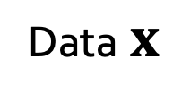
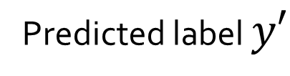

Categorical Domain Adaptation
Encoder E
Predictor F
Data $x$
E
$$z$$
F
Predicted label $y′$
D
Source or target?
Discriminator D

Slide 13
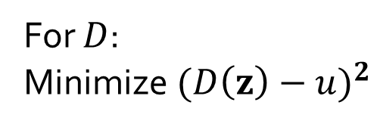
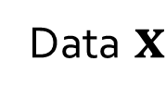
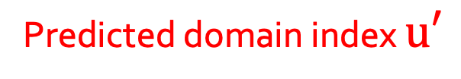

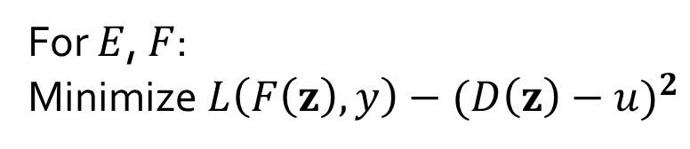
Continuously Indexed Domain Adaptation (CIDA)
Encoder E
Predictor F
Data $x$
E
$$z$$
F
Predicted label $y′$
Domain index $u$
D
Predicted domain index $u′$
For $D$:
Minimize ${(D\left(z\right)−u)}^{2}$
Discriminator D
For $E$, $F$:
Minimize $L\left(F\left(z\right),y\right)−{(D\left(z\right)−u)}^{2}$

Slide 14
Challenge for CIDA
Before training,
Domain 3
Domain 2
Domain 1

Slide 15





Challenge for CIDA
CIDA may end up with
$p(u|z_{1})$
Ideally, after training
$p(u|z_{2})$
$p(u|z_{3})$
$p(u|z_{2})$
$p(u|z_{1})$
$𝔼\left[u | z_{1}\right]=$ $𝔼\left[u | z_{2}\right]=$ $𝔼\left[u | z_{3}\right]=2$
CIDA only matches $𝔼\left[u | z\right]$

Slide 16
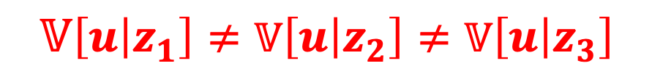

To Improve CIDA
CIDA may end up with
$p(u|z_{1})$
Ideally, after training
$p(u|z_{2})$
$p(u|z_{3})$
$p(u|z_{2})$
$p(u|z_{1})$
$𝔼\left[u | z_{1}\right]=$ $𝔼\left[u | z_{2}\right]=$ $𝔼\left[u | z_{3}\right]$
$$𝕍\left[u | z_{1}\right]≠𝕍\left[u | z_{2}\right]≠𝕍\left[u | z_{3}\right]$$

Slide 17
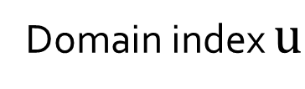
Continuously Indexed Domain Adaptation (CIDA)
Encoder E
Predictor F
Data $x$
E
$$z$$
F
Predicted label $y′$
Domain index $u$
D
Predicted domain index $u′$
For $D$:
Minimize ${(D\left(z\right)−u)}^{2}$
Discriminator D
For $E$, $F$:
Minimize $L\left(F\left(z\right),y\right)−{(D\left(z\right)−u)}^{2}$

Slide 18
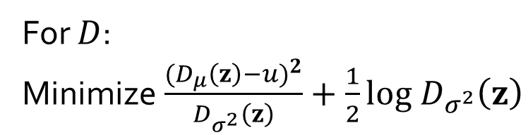
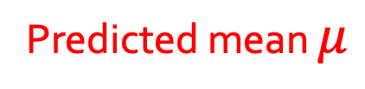
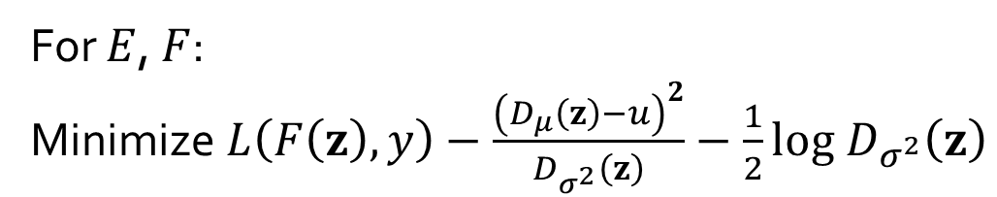
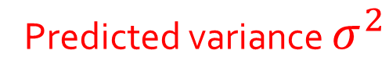
Probabilistic CIDA (PCIDA)
Encoder E
Predictor F
Data $x$
E
$$z$$
F
Predicted label $y′$
Domain index $u$
Predicted mean $μ$
D
Predicted variance $σ^{2}$
For $D$:
Minimize $\frac{{(D_{μ}\left(z\right)−u)}^{2}}{D_{σ^{2}}\left(z\right)}+\frac{1}{2}log D_{σ^{2}}\left(z\right)$
Discriminator D
For $E$, $F$:
Minimize $L\left(F\left(z\right),y\right)−\frac{{\left(D_{μ}\left(z\right)−u\right)}^{2}}{D_{σ^{2}}\left(z\right)}−\frac{1}{2}log D_{σ^{2}}\left(z\right)$
PCIDA matches both $𝔼\left[u | z\right]$ and $𝕍\left[u | z\right]$

Slide 19
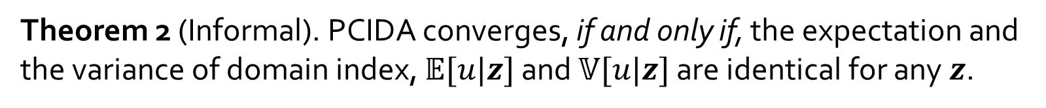
Theoretical Analysis
Theorem 1 (Informal). CIDA converges, if and only if, the expectation of domain index $𝔼[u|z]$is identical for any embedding $z$.
Theorem 2 (Informal). PCIDA converges, if and only if, the expectation and the variance of domain index, $𝔼[u|z]$ and $𝕍[u|z]$ are identical for any $z$.
Theorem 3 (Informal). The global optimum of the two-player game between $E$ and $D$ matches the global optimum of the three-play game between $E$, $F$, and $D$.

Slide 20
Baselines
Single-Step Categorical Domain Adaptation
  ADDA: Adversarial Discriminative Domain Adaptation
  DANN: Domain-Adversarial Training of Neural Networks
  … (more results in the paper)
Multi-Step Categorical Domain Adaptation
  CUA : Continuous Unsupervised Adaptation
Domain 1
Domain 2
Domain 3
Domain 4

Slide 21
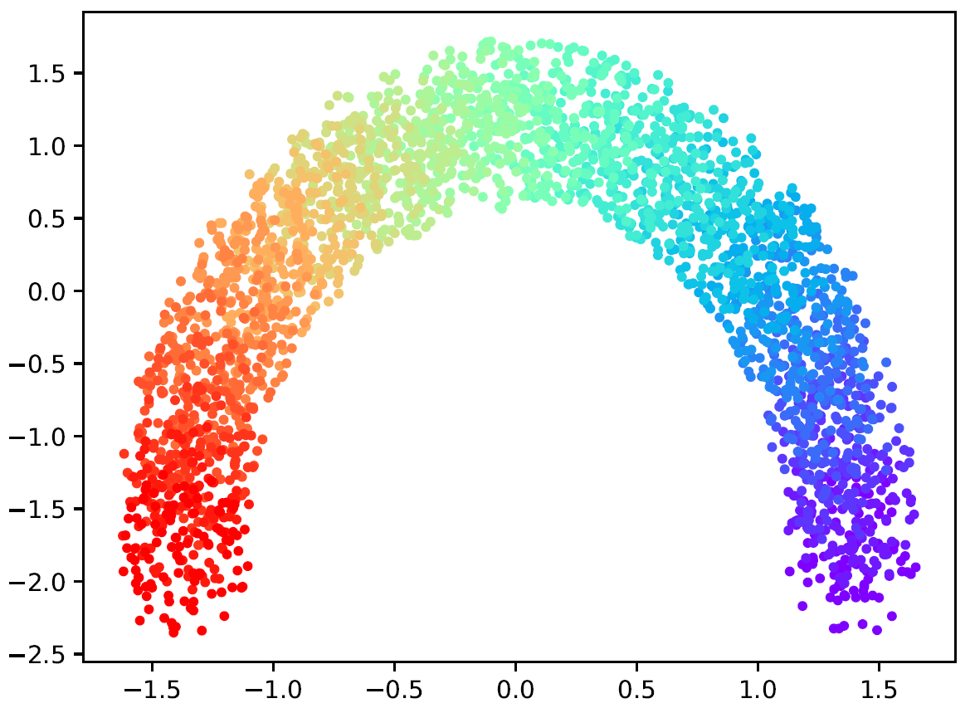
Experiments - Circle
Domain 15
Domain 30
Domain 2
Domain 1
30 continuously indexed domains
Ground-truth labels (red and blue)

Slide 22
Experiments - Circle
The first 6 domains as source domains
Ground-truth labels (red and blue)
with the rest as target domains

Slide 23
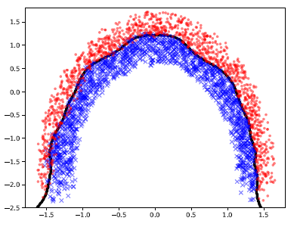
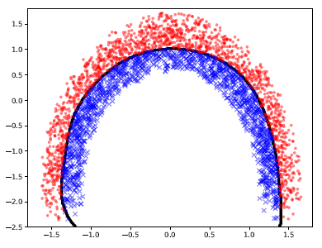
Experiments - Circle
DANN
ADDA
Ground truth
CUA
CIDA

Slide 24
Results (Zoomed in)
Target Part 2
Target Part 1
CUA: Local adaptation. Very rugged boundary.
CIDA: Global adaptation. Very smooth boundary.
Source
Result of applying CUA
Result of applying CIDA

Slide 25
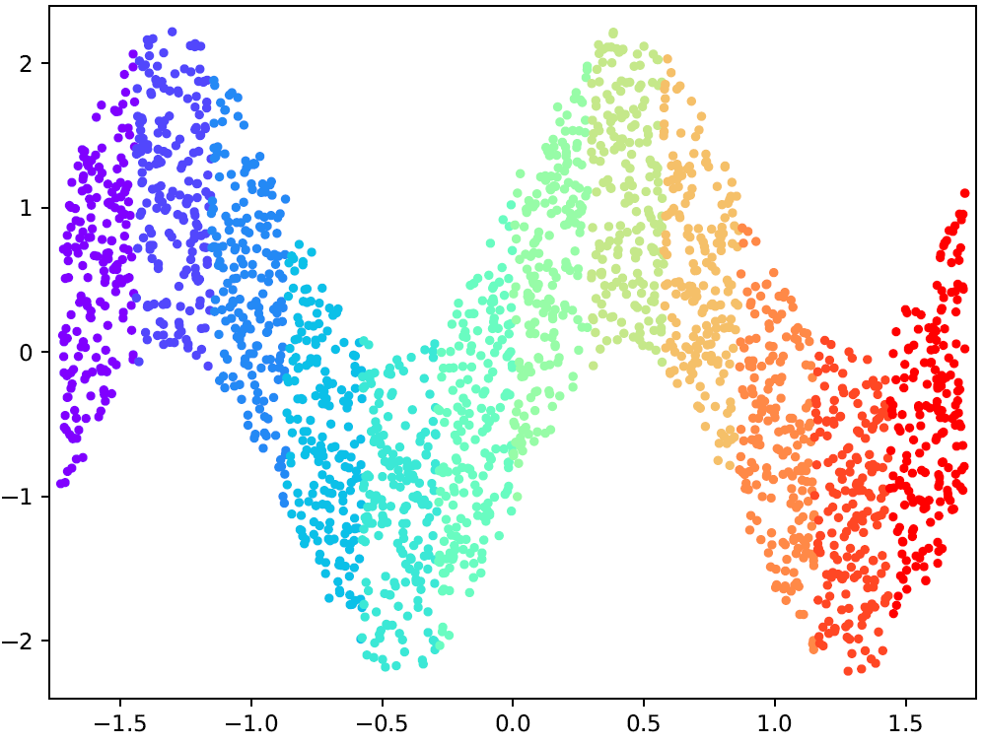
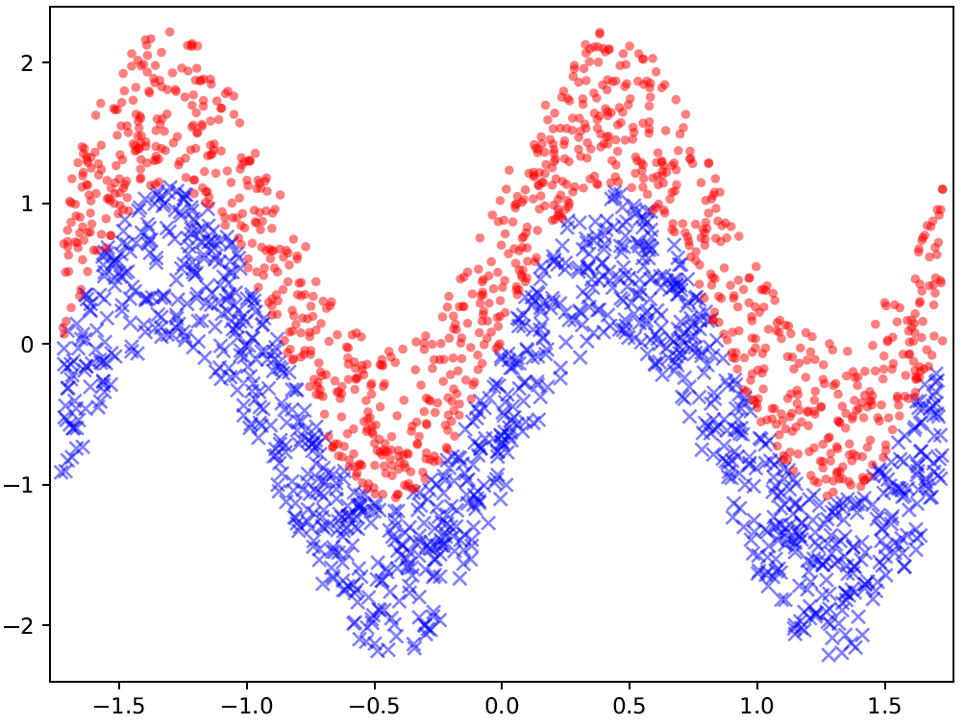
Experiments - Sine
Domain 1
Domain 2
Domain 6
Domain 12
Similar slides to Circle
12 continuously indexed domains
Ground-truth labels (red and blue)

Slide 26
Experiments - Sine
Similar slides to Circle
The first 5 domains as source domains
12 continuously indexed domains
Ground-truth labels (red and blue)
with the rest as target domains

Slide 27
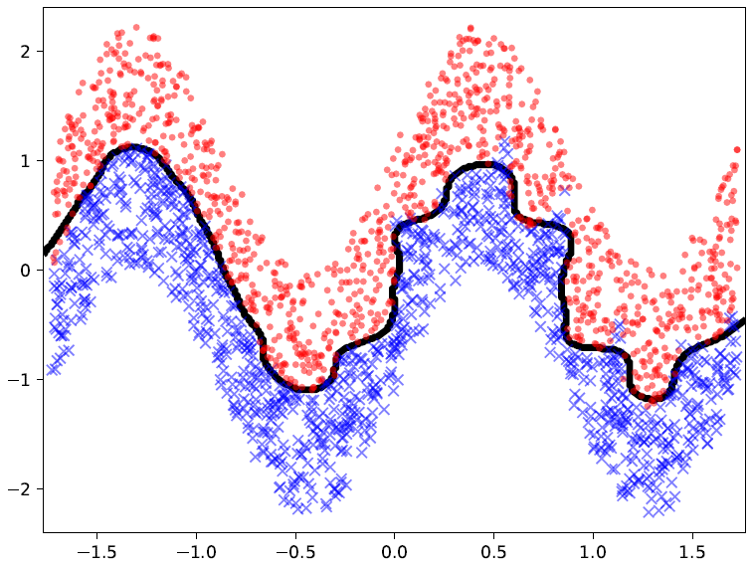
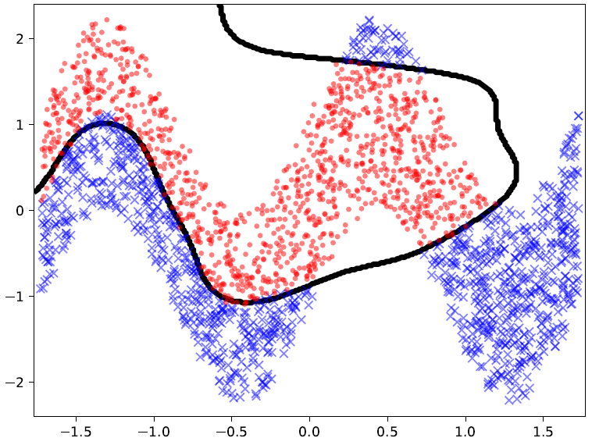
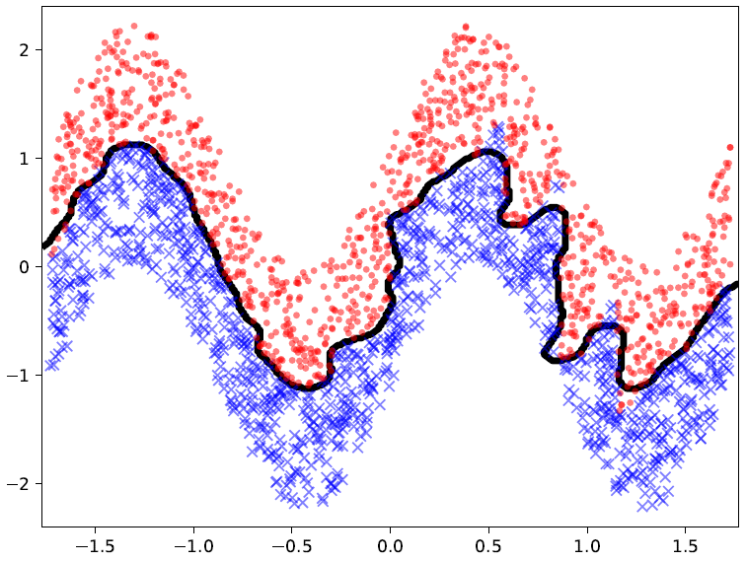
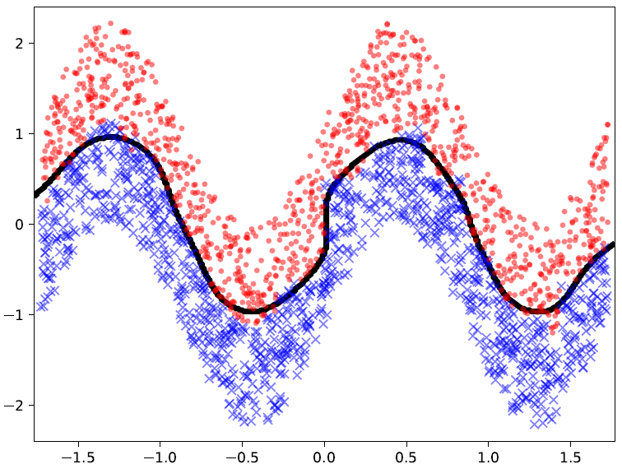
Experiments - Sine
DANN
ADDA
Ground truth
CUA
CIDA

Slide 28
Experiments - Sine
Domain 8 and 9
Domain 6 and 7
Domain 7 and 8
Domain 5 and 6
CUA may fail in an intermediate domain,
causing failure in all following domains.
Ground truth
CUA

Slide 29
Experiments - Sine
Ground truth
CIDA

Slide 30
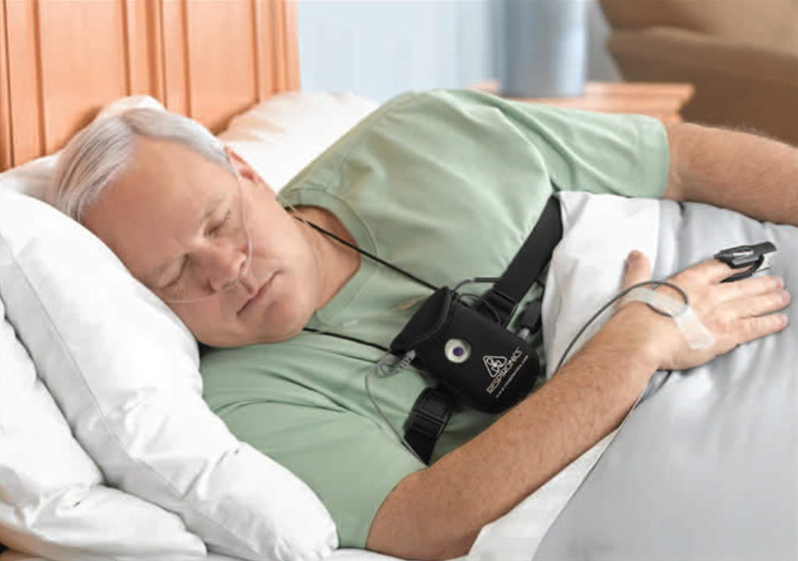
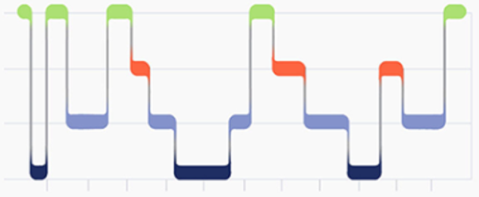
Real-World Medical Scenario
Sleep Study at Home
1. Awake
2. REM
3. Light Sleep
4. Deep Sleep
Predictor
Input Time-Series Signals:
1. Nasal Cannula
2. Breathing Belt

Slide 31
Evaluation on Real-World Datasets
Three Sleep Study Datasets
SHHS: Sleep Heart Health Study
MESA: Multi-Ethnic Study of Atherosclerosis
SOF: Study of Osteoporotic Fractures

Slide 32
Continuous Adaptation Setting: Extrapolation
Source domains
Age
Young
Old
Here ‘age’ is a domain index.

Slide 33
Continuous Adaptation Setting: Interpolation
Source domains
Source domains
Age
Young
Old
Here ‘age’ is a domain index.

Slide 34
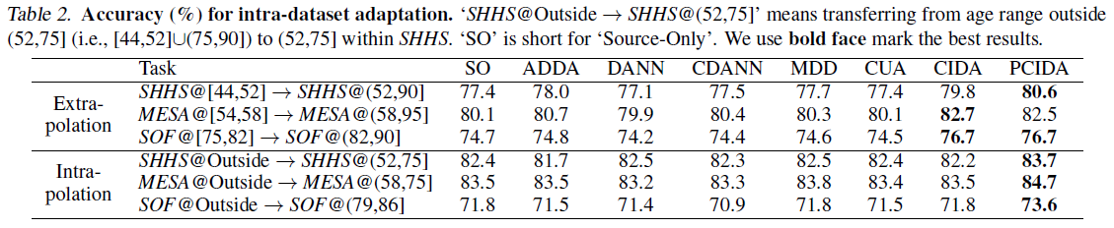
Results on Extra/Inter-polation Adaptation
Source-only
Categorical DA
Ours
Categorical DA may hurt performance.
CIDA/PCIDA improve performance in both settings.
CIDA/PCIDA has larger performance gain in extrapolation since it is harder.

Slide 35
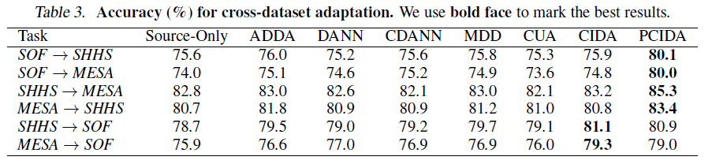
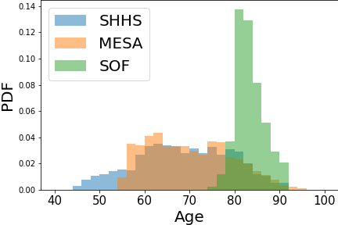
Results on Cross Dataset Adaptation
In the hardest transferring tasks (SOF -> SHHS/MESA), PCIDA is a clear winner.

Slide 36




Multi-Dimensional Domain Index
Domain Index 2:
Physical Wellness
Domain Index 3:
Emotional Wellness
Domain Index 1: Age

Slide 37
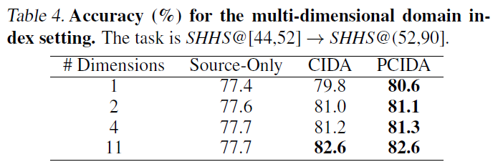
Multi-Dimensional Domain Index
Multi-dimensional domain index:
Age
Physical wellness
Emotional wellness
Fatigue level
…
Multi-dimensional indices further improve performance

Slide 38
Summary
The first general DA method for continuously indexed domain adaptation.
Theoretical guarantees that CIDA aligns continuously indexed domains at equilibrium.
Two advanced versions, probabilistic CIDA (PCIDA) and multi-dimensional CIDA.
State-of-the-art performance on both synthetic and real-world medical datasets.
Code will be released soon at https://github.com/hehaodele/CIDA.

