Slide 1
Earthformer: Exploring Space-Time Transformers for Earth System Forecasting
Zhihan Gao^{2,*}, Xingjian Shi^{1,†}, Hao Wang³, Yi Zhu¹, Yuyang Wang¹, Mu Li¹, Dit-Yan Yeung²
¹Amazon Web Services, ²Hong Kong University of Science and Technology, ³Rutgers University
*Work done while being an intern at Amazon Web Services. †Contact person.
NeurIPS 2022

Slide 2
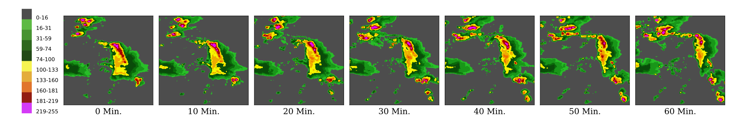
Motivation
Example: Vertically Integrated Liquid (VIL) observation sequence from the Storm EVent ImagRy (SEVIR) dataset
Predicting the future of the complex Earth system
  Applications: precipitation nowcasting, El Niño/Southern Oscillation (ENSO) Sea Surface Temperature (SST) forecasting, etc.
  Huge socioeconomic impact: help avoid crises, better utilize natural resources, etc.
Data-driven approach based on DL is becoming popular
  Most architectures based on CNN/RNN.
  Challenges: chaotic, high dimensional, spatiotemporal.
Goal: Explore space-time Transformers for this task.
Notes:
The Earth is a complex system.
Improving forecasting models for the variabilities of Earth has a huge socio-eco’nomic impact.
E.g., it can help people take necessary precautions to avoid crises, or better utilize natural resources such as wind and solar energy. [click]
Conventionally, Earth system forecasting relies on expensive numerical simulation.
In recent years, data-driven Deep Learning (DL) models, typically CNN and RNN based models, are demonstrating impressive potential.
However, it is unclear whether the inductive biases in these models still hold for such chaotic and high dimensional, spatiotemporal systems [click]
On the other hand, the widely used Transformer, which is powerful at modeling complex and long-range dependencies, has limited adoption in this area.
Our work Earthformer hence aims at exploring the design of space-time Transformers for this Earth system forecasting task.

Slide 3
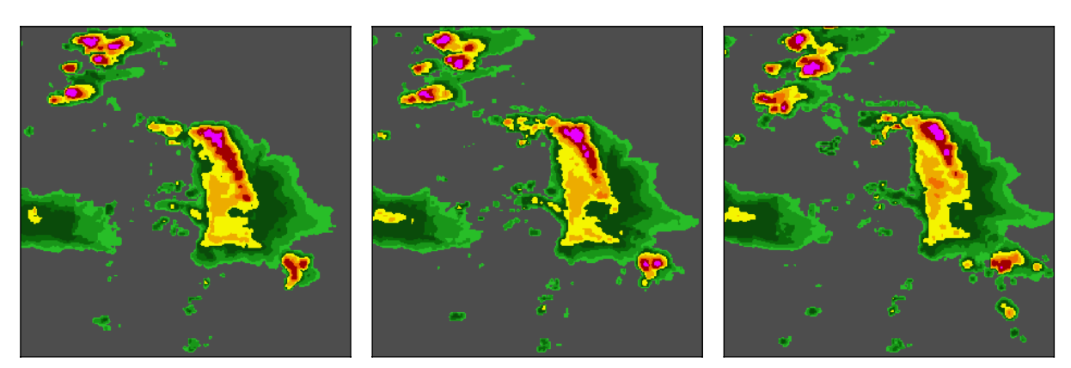
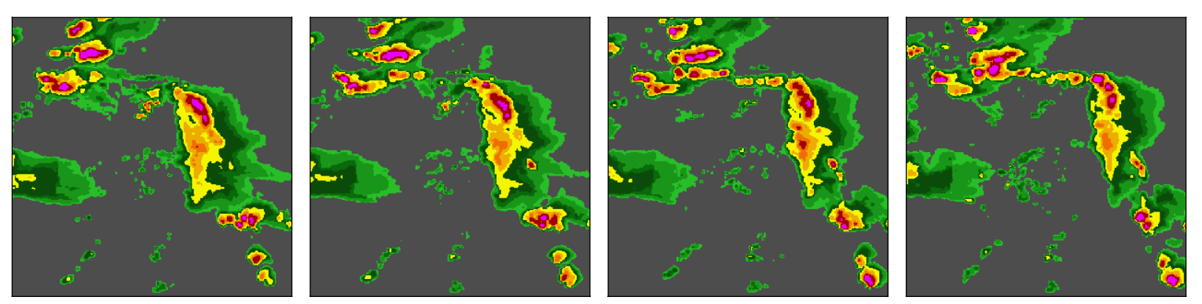








Earth System Forecasting – Formulation and General Architecture
Formulate Earth system forecasting as spatiotemporal sequence forecasting
  Input: ${[𝒳_{i}]}_{i=1}^{T},𝒳_{i}∈ ℝ^{H × W × C_{in}}$
  Target: ${[𝒴_{T+i}]}_{i=1}^{K},𝒴_{i}∈ ℝ^{H × W × C_{out}}$
Hierarchical encoder-decoder architecture
Encoder
Decoder
$$𝒳_{1}$$
$$𝒳_{2}$$
$$𝒳_{3}$$
$$𝒴_{4}$$
$$𝒴_{5}$$
$$𝒴_{6}$$
$$𝒴_{7}$$
Notes:
We formulate Earth system forecasting as a spatiotemporal sequence forecasting problem.
Our proposed Earthformer is a hierarchical Transformer encoder-decoder based on Cuboid Attention. [click]
The encoder [click]
encodes the T-step observations into latent states, [click]
and then feeds them into the decoder [click]
to predict the K-step-ahead future.

Slide 4



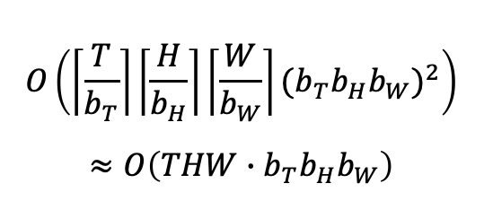


Cuboid Attention – Decompose, Attend, Merge
$$𝒳_{out}∈ ℝ^{T × H × W × C}$$
$$𝒳∈ ℝ^{T × H × W × C}$$
self attention & update
reshape back
flatten
concat global vecs
for each cuboid
decompose
merge
$$𝒳∈ ℝ^{T × H × W × C},𝒢∈ ℝ^{P× C}$$
Complexity of cuboid attention
$$O\left(\left\lceil \frac{T}{b_{T}}\right\rceil \left\lceil \frac{H}{b_{H}}\right\rceil \left\lceil \frac{W}{b_{W}}\right\rceil {(b_{T}b_{H}b_{W})}^{2}\right)$$
$$≈O\left(THW∙b_{T}b_{H}b_{W}\right)$$
Complexity of cuboid attention + global vectors
$$O\left(THW∙b_{T}b_{H}b_{W}\right)+O(THW∙P+P^{2})$$
Relatively small. P < 8
$$𝒢_{out}∈ ℝ^{P× C}$$
$$𝒢∈ ℝ^{P× C}$$
4
Notes:
Within each Cuboid Attention layer, [click]
the spatiotemporal tensor X is first decomposed according to a certain cuboid pattern, [click]
then within each [click]
decomposed cuboids, self-attention is performed locally, and finally, [click]
they are reshaped back and merged to the original input shape. [click]
Besides, [click]
we add several extra global vectors G to enable information exchange among cuboids.
This can avoid quadratic complexity in full attention.

Slide 5
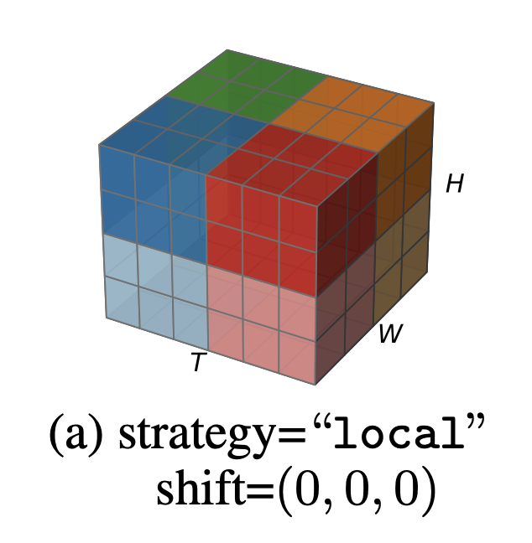
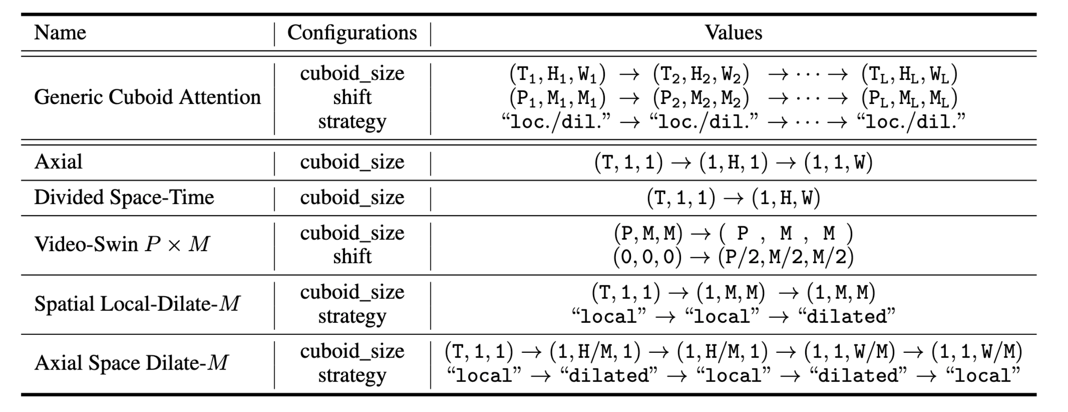
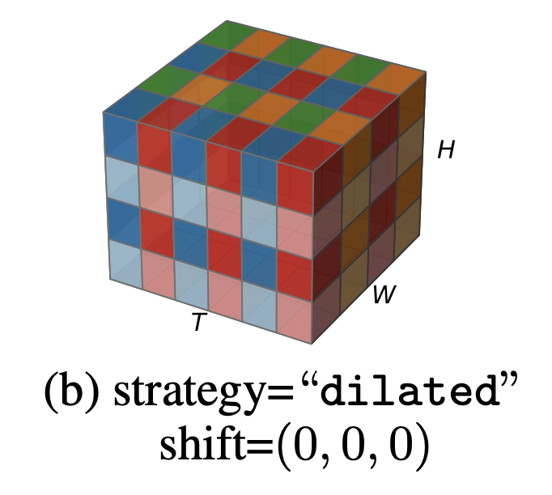
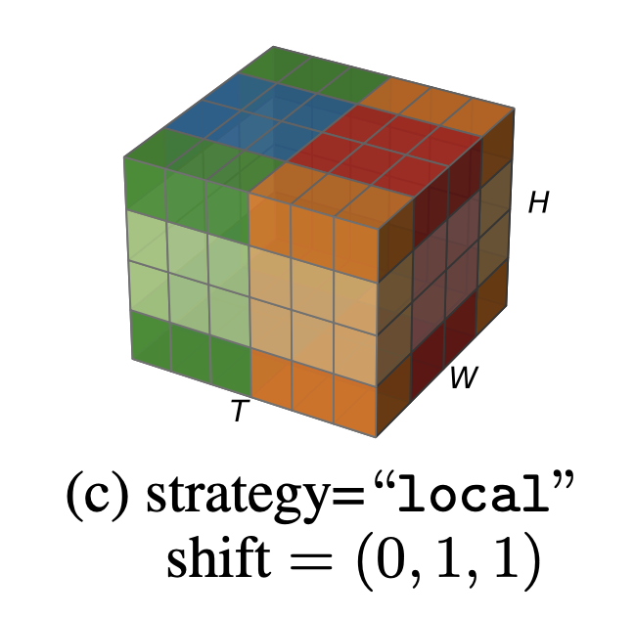
Cuboid Attention – Decomposition Pattern
Decomposition → correlation pattern. Stack different patterns.
[1] Axial Attention in Multidimensional Transformers, https://arxiv.org/abs/1912.1218
[2] Video Swin Transformer, https://arxiv.org/abs/2106.13230
[3] Is Space-Time Attention All You Need for Video Understanding?, https://arxiv.org/abs/2102.05095
Notes:
Our cuboid attention is a [click]
generic building block for space-time attention.
By stacking multiple cuboid attention layers with different cuboid patterns, [click]
we are able to efficiently explore existing and potentially more effective [click]
space-time attention.
The configurations [click]
of the cuboid attention patterns explored in our paper are listed in this table.

Slide 6
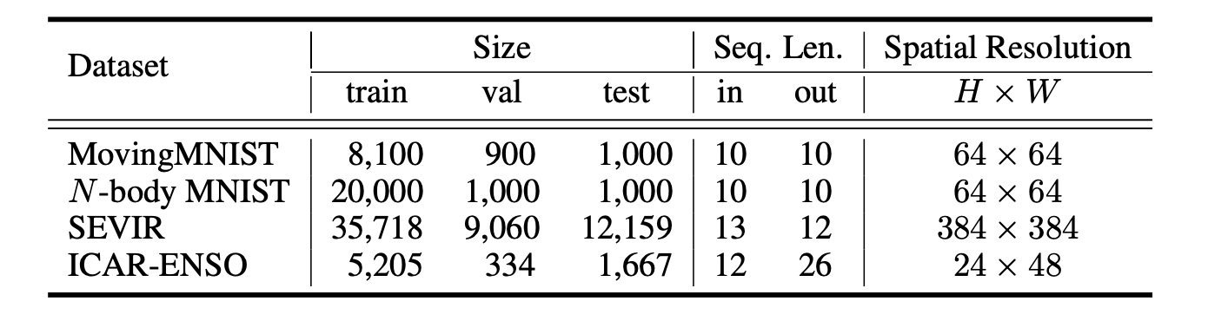
Experiments – Dataset Statistics
Earth observation data are noisy. Previous spatiotemporal forecasting papers rely on MovingMNIST. We proposed a more challenging synthetic dataset named N-body MNIST extended based on MovingMNIST .
[1] SEVIR : A Storm Event Imagery Dataset for Deep Learning Applications in Radar and Satellite Meteorology, NeurIPS 2020
[2] Deep learning for multi-year ENSO forecasts, Nature 2019
Notes:
In our experiments, we conduct empirical studies on two synthetic datasets [click]
MovingMNIST, and our newly proposed N-body MNIST,
and two real-world datasets, [click]
SEVIR for precipitation nowcasting, and ICAR-ENSO for Sea Surface Temperature Anomalies Forecasting in El Niño/Southern Oscillation. [click]
Previous spatiotemporal forecasting papers rely on MovingMNIST, where there are no long-range and complex interactions among moving digits.
We extend MovingMNIST to a more challenging N-body MNIST.

Slide 7
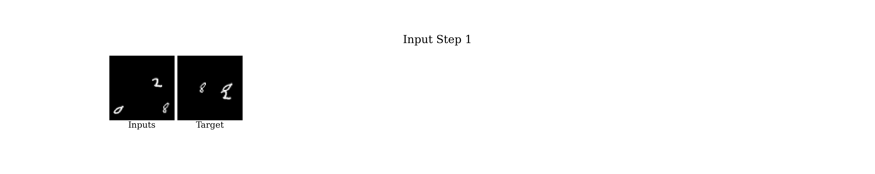
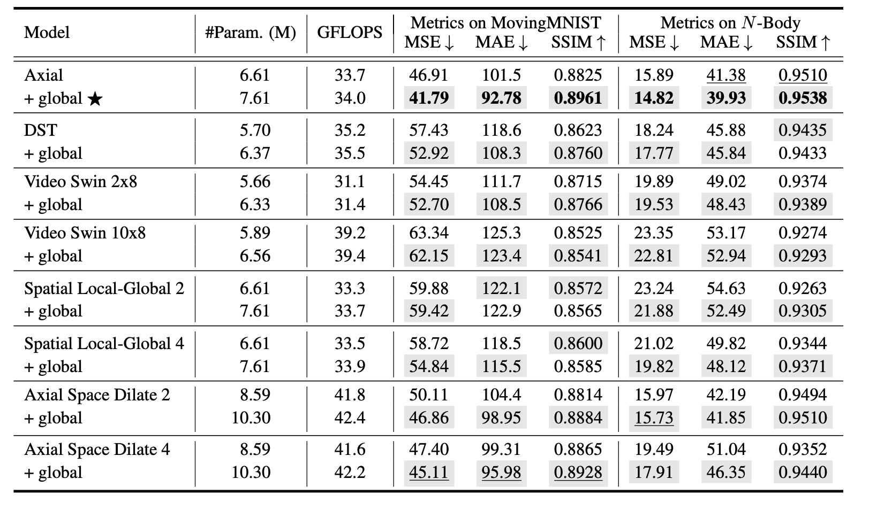
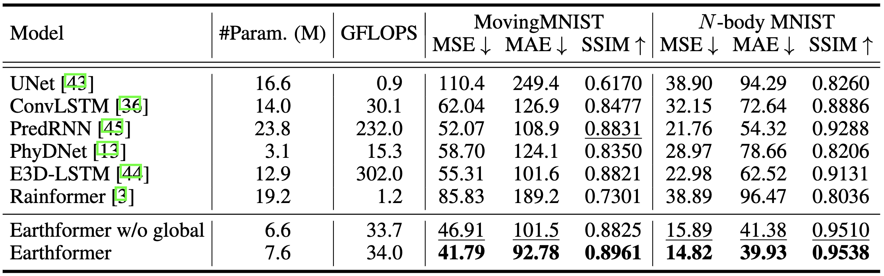
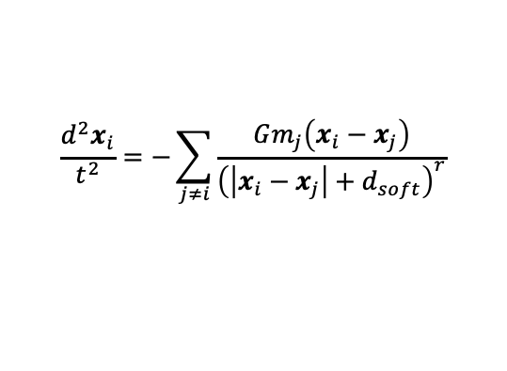
Results – MovingMNIST & N-body MNIST
N-body MNIST: 3 digits moving according to the chaotic 3-body motion pattern.
Earthformer gives the correct and precise position of the digits.
$$\frac{d^{2}x_{i}}{t^{2}}=−\sum_{j≠i}{\frac{Gm_{j}\left(x_{i}−x_{j}\right)}{{\left(\left|x_{i}−x_{j}\right|+d_{soft}\right)}^{r}}}$$
“Axial” + global performs the best
Adding global vectors gives consistent performance improvement without increasing GFLOPS too much.
Notes:
Each digit in our newly proposed N-body MNIST has its mass and is subjected to the gravity from other digits. The digits hence follow the chaotic 3-body motion.
N-body MNIST requires the forecasting model to be capable of modeling long-range and complex interactions, which are ubiquitous in Earth system, to generate correct and precise predictions of future trajectories of digits. [click]
The experiments conducted on MovingMNIST N-body MNIST figure out the best choice of the cuboid pattern and demonstrate the effectiveness of adding extra global vectors. [click]
Comparison with baselines shows that Earthformer can learn long-range and complex interactions better.

Slide 8
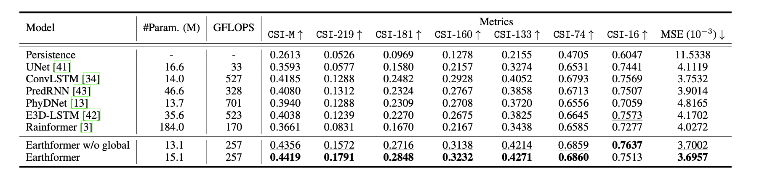
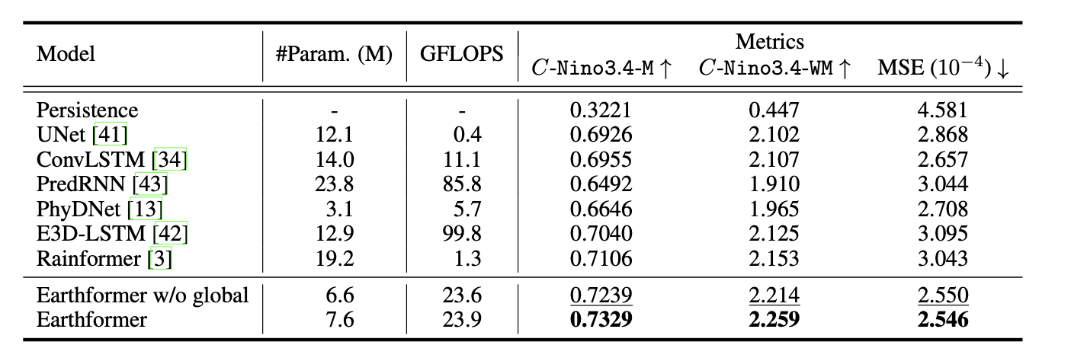
Results – Performance on SEVIR and ICAR-ENSO
SOTA performance on two real-world benchmarks
SEVIR
ICAR-ENSO
Notes:
Earthformer also achieves SOTA on real-world precipitation nowcasting benchmark SEVIR and Sea Surface Temperature Anomalies Forecasting challenge ICAR-ENSO, [click]
in both MSE and task-specific metrics.

Slide 9
Conclusions
Contributions
  First work that explores space-time Transformer for Earth system forecasting.
  Generic building block “Cuboid attention”
    Input tensor → non-overlapping cuboids → cuboid-level attention
    Global vectors that connect the local cuboids.
  SOTA performance on 4 benchmarks.
Future Works
  Incorporate physical knowledge.
  Extend Earthformer to a probabilistic forecasting model to handle uncertainty.
Source code and pretrained models are released!
  https://github.com/amazon-research/earth-forecasting-transformer
Notes:
To conclude our paper
Our Earthformer is the first to explore space-time Transformer for Earth system forecasting, with novel generic building block called cuboid attention.
Earthformer achieves SOTA performance on 2 synthetic datasets and 2 real-world benchmarks
In the future, we plan to study how to incorporate physical knowledge into Earthformer and extend Earthformer to a probabilistic forecasting model to better handle uncertainty.
The source code of Earthformer and the pretrained weights are now publicly available.
Please feel free to check them on github.

Slide 10
Thank you!

