Slide 1
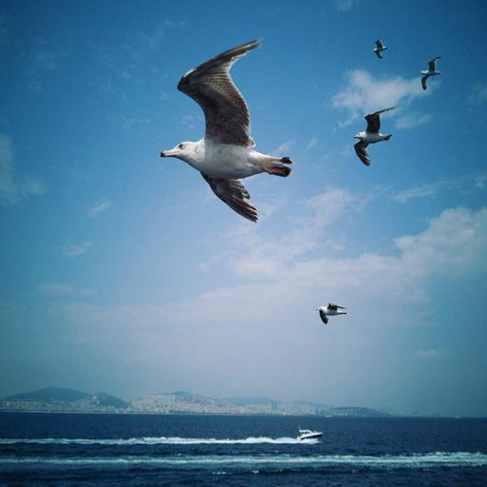

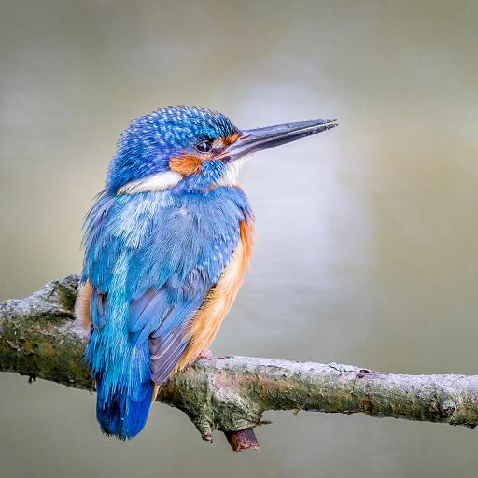
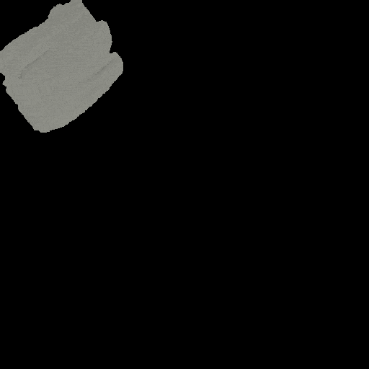






Paint Transformer: Feed-Forward
Neural Painting with Stroke Prediction
Songhua Liu*, Tianwei Lin*, Dongliang He, Fu Li,
Ruifeng Deng, Xin Li, Errui Ding, Hao Wang
Notes:
Hello everyone, welcome to this introduction of our work: Paint Transformer: Feed-Forward Nerual Painting with Stroke Prediction.

Slide 2
Neural Painting
Definition:
  Given a target image
  Generate a series of parameterized strokes
  These strokes can non-photorealistically recreate the target image
Two Major Components:
  Stroke Predictor
    Image → Parameterized Strokes
    In neural painting, neural networks are widely used
  Stroke Renderer
    Parameterized Strokes → Painting Results
    Should be differentiable for optimization

Slide 3
Existing Methods
Reinforcement learning (RL) baseline (e.g., Huang et al. ICCV 2019)
  Fast inference
  The stroke predictor is hard to train
  Lack of artistic abstraction
Stroke optimization (Optim) baseline (e.g., Zou et al. CVPR 2021)
  Do not need training for stroke predictor
  Unsatisfactory inference speed
Our approach: stroke set prediction
  Fast training: less than 4 hours on a single GPU
  Fast inference: near real time under 512 * 512 resolution

Slide 4
Our Contribution
A new perspective for neural painting:
  View neural painting as a set prediction problem
  Parameters of a set of strokes are generated in parallel
  Build a bridge with object detection problem
A novel transformer-based stroke predictor :
  Inspired by DETR (Carion et al. ECCV 2020)
  Strokes are predicted as rotated objects
A novel self-training pipeline:
  No training data is available for stroke predictor
  Use randomly synthesized data!

Slide 5
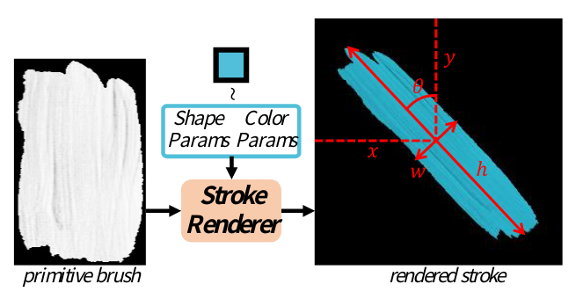
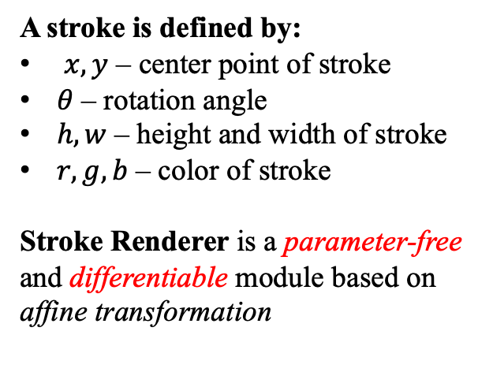
Our Method – Stroke Definition & Renderer
A stroke is defined by:
$x, y$ – center point of stroke
$θ$ – rotation angle
$h, w$ – height and width of stroke
$r, g, b$ – color of stroke
Stroke Renderer is a parameter-free and differentiable module based on affine transformation

Slide 6
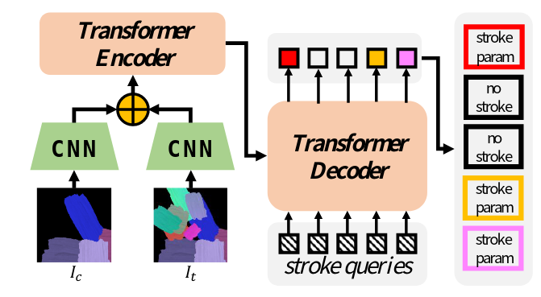
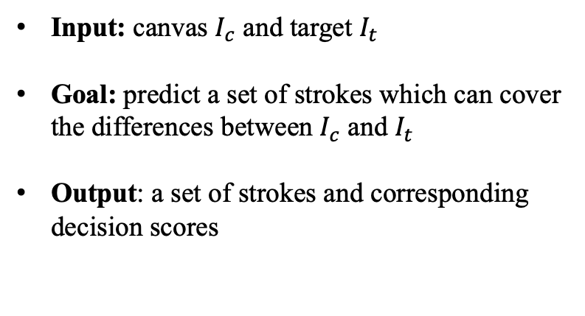
Our Method – Stroke Renderer & Stroke Predictor
Input: canvas $I_{c}$ and target $I_{t}$
Goal: predict a set of strokes which can cover the differences between $I_{c}$ and $I_{t}$
Output: a set of strokes and corresponding decision scores

Slide 7
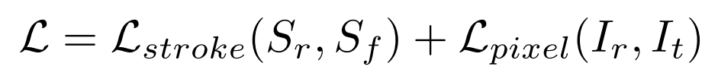
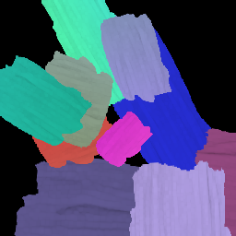
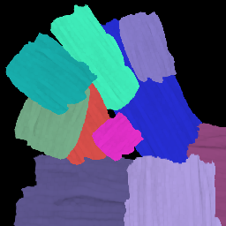
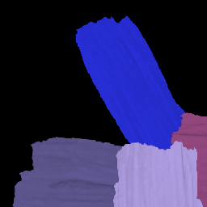

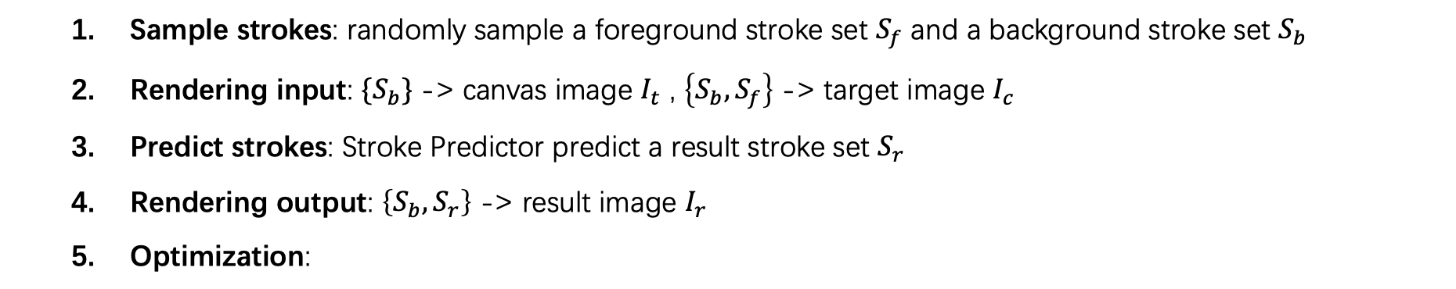





Our Method – Self-training Framework
  Sample strokes: randomly sample a foreground stroke set $S_{f}$ and a background stroke set $S_{b}$
  Rendering input: ${\{S}_{b}\}$ -> canvas image $I_{t}$ , $\left\{S_{b},S_{f}\right\}$ -> target image $I_{c}$
  Predict strokes: Stroke Predictor predict a result stroke set $S_{r}$
  Rendering output: $\left\{S_{b},S_{r}\right\}$ -> result image $I_{r}$
  Optimization:
stroke loss
$$S_{f}$$
pixel loss
Foreground
Strokes
Stroke
Renderer
…
Stroke
Render
$$S_{r}$$
Stroke
Predictor
Prediction
Strokes
Stroke
Renderer
Stroke
Render
Target Image $I_{t}$
$$S_{b}$$
…
Background
Strokes
Stroke
Renderer
Predict Image $I_{r}$
…
stroke queries
Blank Canvas
Canvas Image $I_{c}$

Slide 8
Our Method – Training Objective
Image level:
  Pixel-wise L1 loss
Stroke level:
  Distance between two strokes
    Parameter-wise L1 distance
    Wasserstein distance following work in rotational object detection (Yang et al. ICML 2021)
    Binary cross entropy to measure the confidence similarity
  Similar to DETR, we find the optimal permutations for generated strokes and target strokes using Hungarian algorithm, which produce minimal total stroke distances
  Loss in stroke level is computed under the optimal permutations

Slide 9
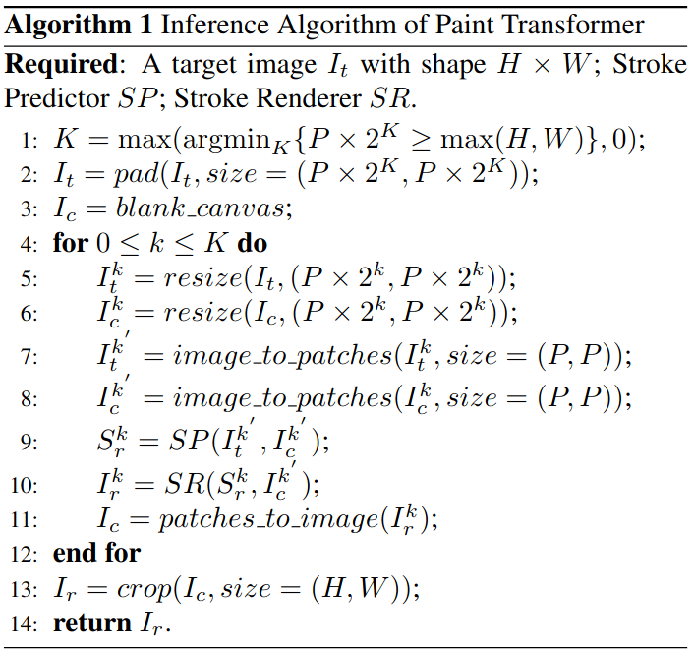
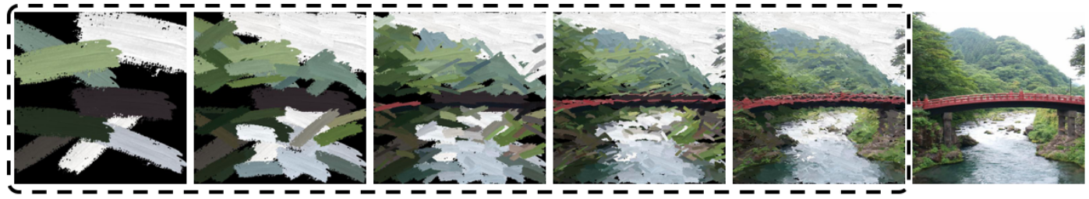
Our Method – Coarse-to-Fine Inference
Inference is conducted on several coarse-to-fine scales
Painting on each scale is dependent on result of the previous scale
In each scale, several non-overlapped patches would be processed independently in parallel
Result of each scale is derived by combining those patches together

Slide 10
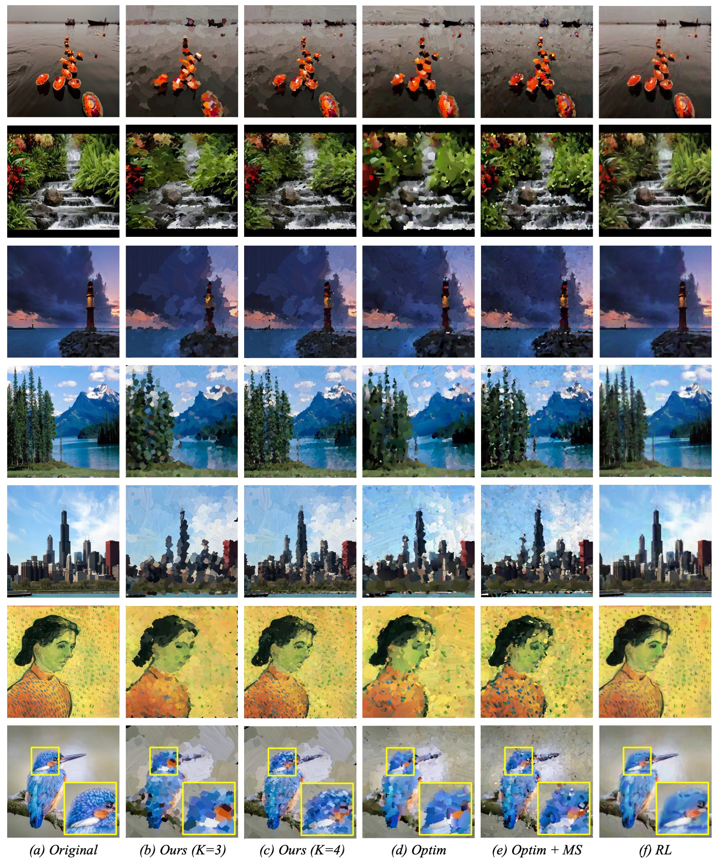
Experiments - Qualitative Comparisons

Slide 11
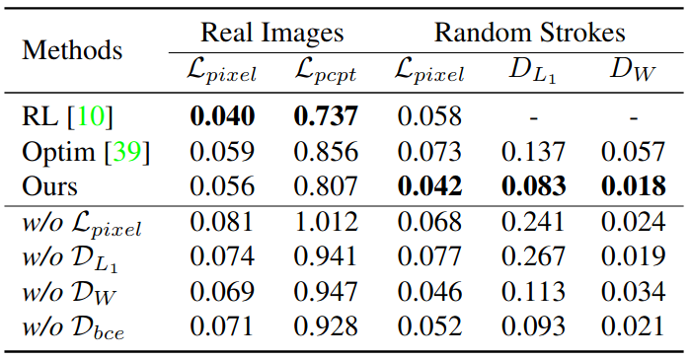
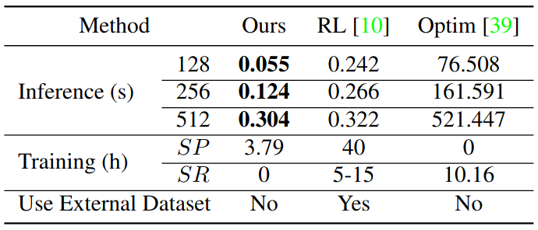
Experiments - Quantitative Comparisons
Target Recreation
Efficiency Comparison

Slide 12
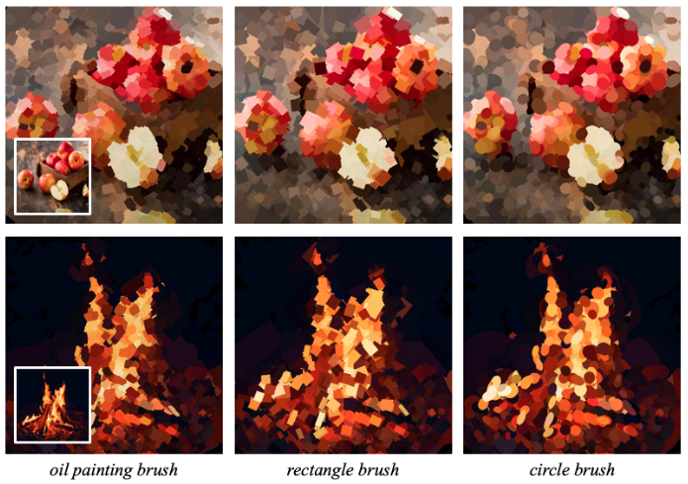
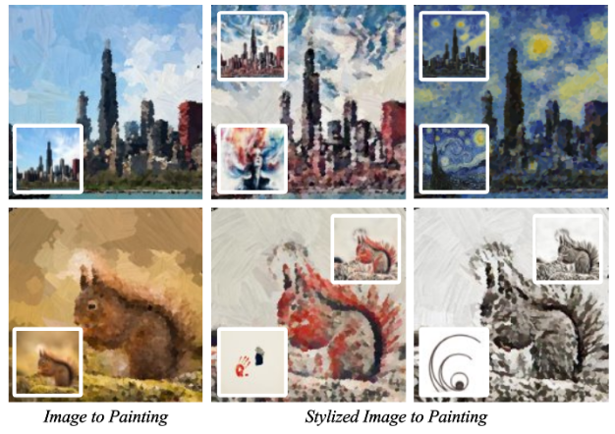
More Interesting Extensions
Generalize to other primitive brushes
Stylized Painting

Slide 13
Conclusion
Paint Transformer re-formulates the neural painting problem from a set prediction perspective and predicts a set of strokes in a feed-forward way
A self-training pipeline based on synthesized data is proposed, which demonstrates excellent generalization ability on real-world image
Experiments demonstrate that Paint Transformer can generate paintings with better trade-off between artistic abstraction and realism, compared to state-of-the-art methods, while maintaining high efficiency.
Codes are released on https://github.com/wzmsltw/PaintTransformer
Contact: songhua.liu@smail.nju.edu.cn or lintianwei01@baidu.com

