Slide 1


Context Uncertainty in Contextual Bandits with Applications to Recommender Systems
Hao Wang, Yifei Ma, Hao Ding, Yuyang (Bernie) Wang
AAAI 2022 Oral

Slide 2
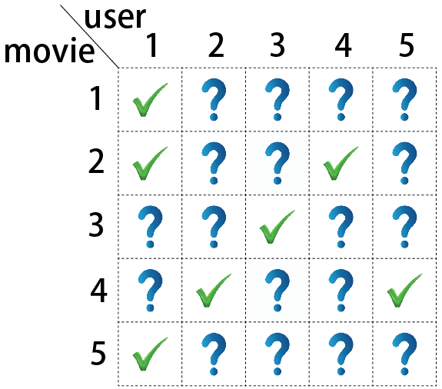


Recommender Systems
2
Rating matrix:
Observed preferences:
To predict:
Matrix completion

Slide 3
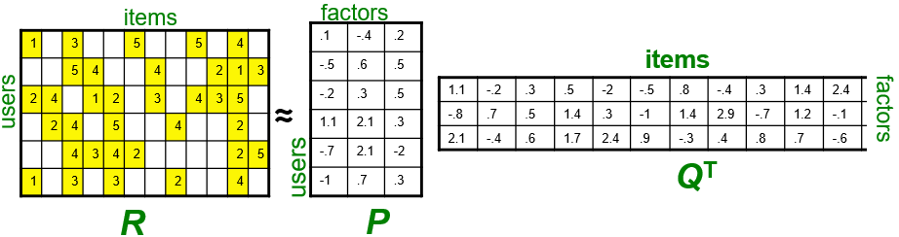


Latent Representations in Modern Recommender Systems
3
Latent Representation via Matrix Factorization
Latent representation (factors) $p$ for a user
Latent representation (factors) $q$ for an item
Predict the rating from a user to an item using the inner product $p^{T}⋅q$
Koren et al. Matrix factorization techniques for recommender systems. Computer 42.8 (2009): 30-37.

Slide 4
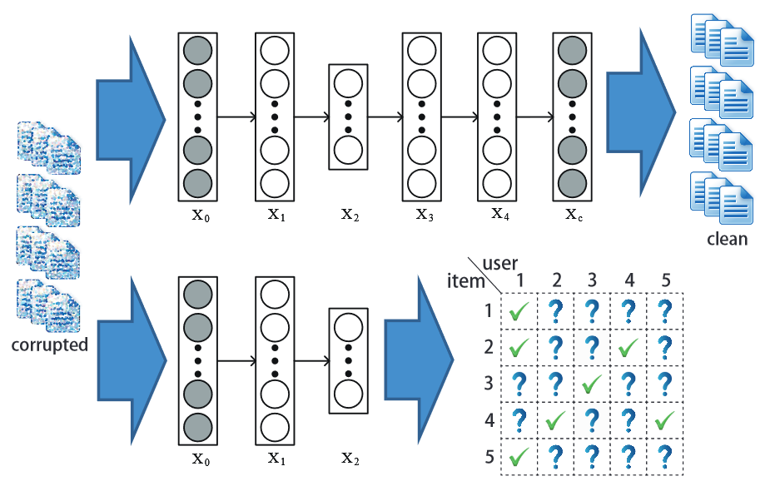
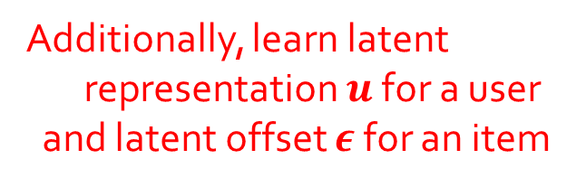
Latent Representations in Modern Recommender Systems
4
Deep Latent Representation via Collaborative Deep Learning
Additionally, learn latent
representation $u$ for a user
and latent offset $ε$ for an item
Deep latent representation $x$ for an item from neural networks
Predict the rating from a user to an item using the inner product $u^{T}⋅(x+ε)$
Wang et al. Collaborative deep learning for recommender systems. KDD 2015.
Wang et al. Collaborative recurrent AE for recommender systems. NIPS 2016.
Notes:
Modern recommender systems rely heavily on representations in the latent space

Slide 5
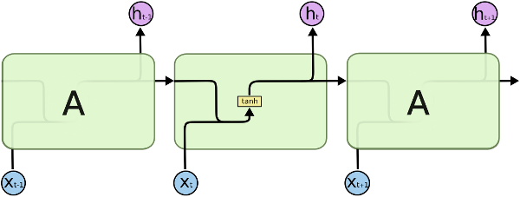
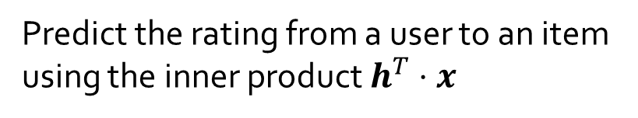
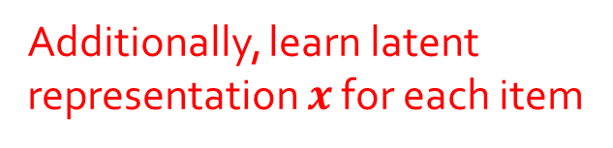
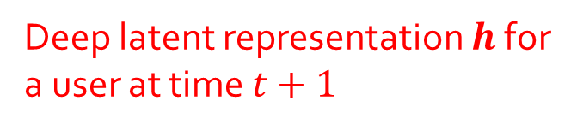
Latent Representations in Modern Recommender Systems
5
Deep Latent Representation via Recurrent Neural Networks
Deep latent representation $h$ for
a user at time $t+1$
Additionally, learn latent
representation $x$ for each item
Predict the rating from a user to an item
using the inner product $h^{T}⋅x$
Performance relies heavily on the quality of representations in the latent space
Hidasi et al. Session-based recommendations with recurrent neural networks. ICLR 2016.
Ma et al. Temporal-Contextual Recommendation in Real-Time. KDD 2020.
Notes:
Latent representation $x$ for
the user’s $(t+1)$-th purchased item

Slide 6

The Need for Exploration
6
Reward
(Accuracy)
Time
Find the user likes action movies,
and keep recommending her action movies.
Reward increases.
Reward saturated.

Slide 7
The Need for Exploration
7
Reward
(Accuracy)
Time
Find the user likes action movies, recommend
her action movies and other movies.
Reward increases.
Reward keep increasing.

Slide 8
Chicken-and-Egg Problem
8
Recommendations rely on learned latent representations
Need
Effective
Exploration
Good Latent
Representations
Need
Exploration happens in the latent space
Notes:
If a RS never recommends an item to the users, it will never learn a good representation for that item. RS need to explore different items to learn better representations for them.

Slide 9
Solution: Context Uncertainty
9
Recommendations rely on learned latent representations
Context Uncertainty
(Latent Representation Uncertainty)
Effective
Exploration
Good Latent
Representations

Slide 10
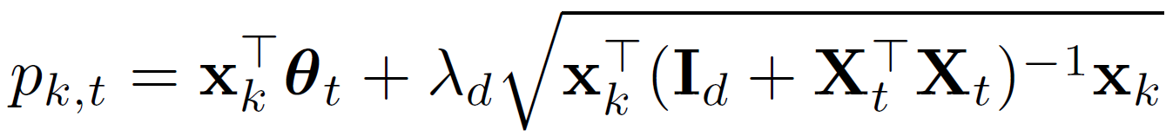

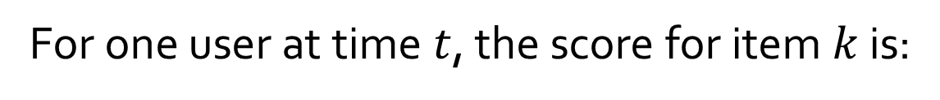
Relevance + Diversity
10
For one user at time $t$, the score for item $k$ is:
Latent representation
for item k
Latent representation
for this user at time t
Relevance Term
Diversity Term
Notes:
For one user at time $t$, the score for item $k$ is the sum of 2 terms, a relevance term and a diversity term
Theta t can come from any deep learning model, it takes the user’s purchased items until time t as input, and output the user representation at time t

Slide 11
Relevance + Diversity
11
For one user at time $t$, the score for item $k$ is:
Collection of latent representations for
t-1 items this user purchased before time t
Relevance Term
Diversity Term
Notes:
For one user at time $t$, the score for item $k$ is the sum of 2 terms, a relevance term and a diversity term

Slide 12
Relevance + Diversity
12
For one user at time $t$, the score for item $k$ is:
Measures what has been explored:
the latent space this user has explored until time t
Relevance Term
Diversity Term
Notes:
For one user at time $t$, the score for item $k$ is the sum of 2 terms, a relevance term and a diversity term

Slide 13
Relevance + Diversity
13
For one user at time $t$, the score for item $k$ is:
Measures what has been explored (regularized):
the latent space this user has explored until time t
Relevance Term
Diversity Term
Notes:
For one user at time $t$, the score for item $k$ is the sum of 2 terms, a relevance term and a diversity term

Slide 14
Relevance + Diversity
14
For one user at time $t$, the score for item $k$ is:
Measures what has NOT been explored:
the latent space this user has NOT explored until time t
Relevance Term
Diversity Term
Notes:
For one user at time $t$, the score for item $k$ is the sum of 2 terms, a relevance term and a diversity term

Slide 15
Relevance + Diversity
15
For one user at time $t$, the score for item $k$ is:
Diversity score for item k:
how item k is different from this user’s previous items
Relevance Term
Diversity Term
Exploration based on diversity in the latent space.
Is it sufficient?
Notes:
For one user at time $t$, the score for item $k$ is the sum of 2 terms, a relevance term and a diversity term

Slide 16
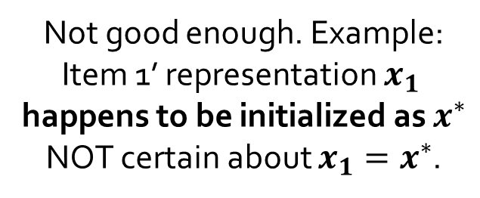
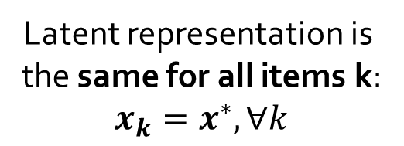
Relevance + Diversity: Not Good Enough
16
For one user at time $t$, the score for item $k$ is:
Diversity score for item k
Relevance Term
Diversity Term
Not good enough. Example:
Item 1’ representation $x_{1}$
happens to be initialized as $x^{∗}$
NOT certain about $x_{1}=x^{∗}$.
Latent representation is
the same for all items k:
$$x_{k}=x^{∗},∀k$$
All items have
identical diversity scores
Notes:
For one user at time $t$, the score for item $k$ is the sum of 2 terms, a relevance term and a diversity term

Slide 17
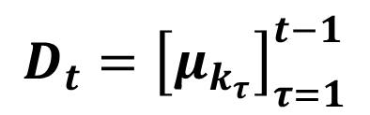
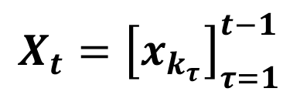


Relevance + Diversity: Not Good Enough
17
For one user at time $t$, the score for item $k$ is:
Relevance Term
Diversity Term
To capture uncertainty, consider both mean and variance of item representation $x_{k}$
$$x_{k}$$
$$(μ_{k},σ_{k}^{2})$$
$$X_{t}={\left[x_{k_{τ}}\right]}_{τ=1}^{t−1}$$
$$D_{t}={\left[μ_{k_{τ}}\right]}_{τ=1}^{t−1}$$
Notes:
For one user at time $t$, the score for item $k$ is the sum of 2 terms, a relevance term and a diversity term

Slide 18
Relevance + Diversity + Uncertainty
18
For one user at time $t$, the score for item $k$ is:
Relevance Term
Diversity Term
Uncertainty Term

Slide 19
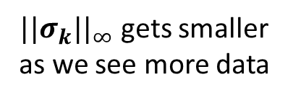
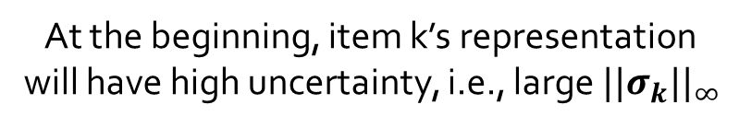
Relevance + Diversity + Uncertainty
19
For one user at time $t$, the score for item $k$ is:
Uncertainty score for item k:
how uncertain about item k’s representation
At the beginning, item k’s representation
will have high uncertainty, i.e., large $||σ_{k}||_{∞}$
System will tend to recommend
Item k more frequently
$||σ_{k}||_{∞}$ gets smaller
as we see more data

Slide 20
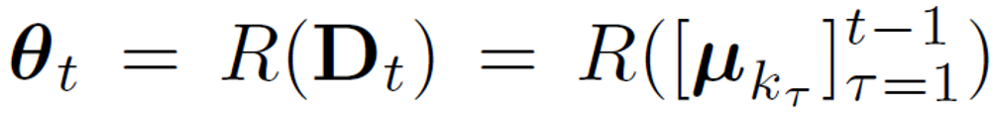
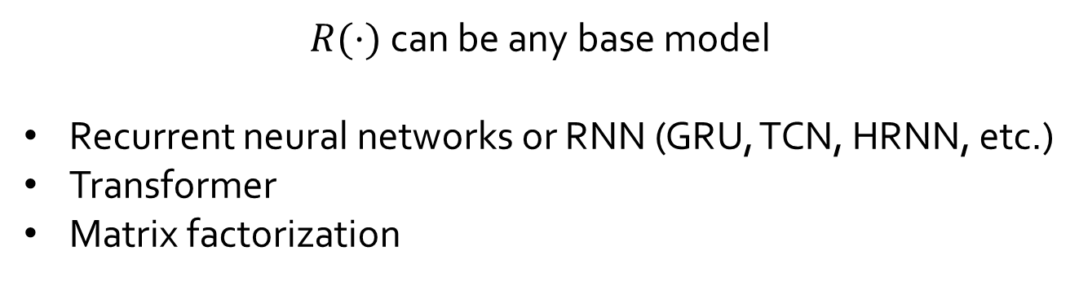
Compatible with Any Base Model
20
as long as the base model uses latent representations
$R(⋅)$ can be any base model
Recurrent neural networks or RNN (GRU, TCN, HRNN, etc.)
Transformer
Matrix factorization

Slide 21
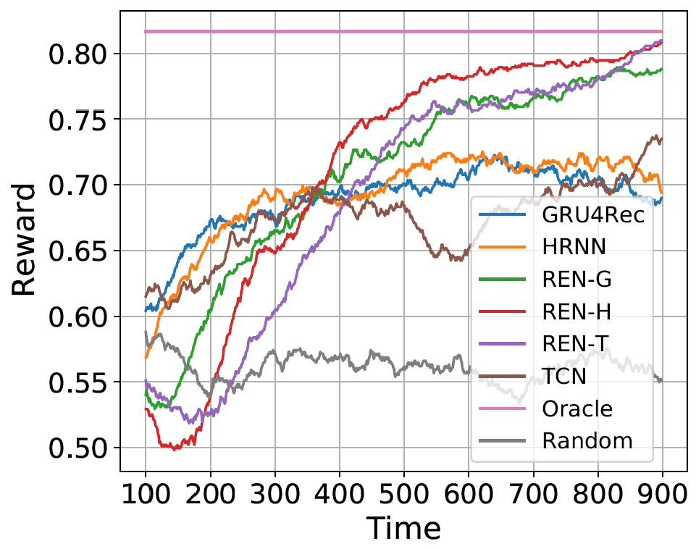
Recurrent Exploration Networks (REN):
Compatible with Any Base Model
21
REN-G (GRU4Rec w/ REN)
REN-T (TCN w/ REN)
REN-H (HRNN w/ REN)
GRU4Rec
TCN
HRNN

Slide 22
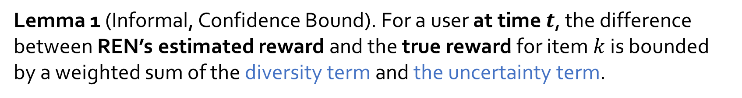
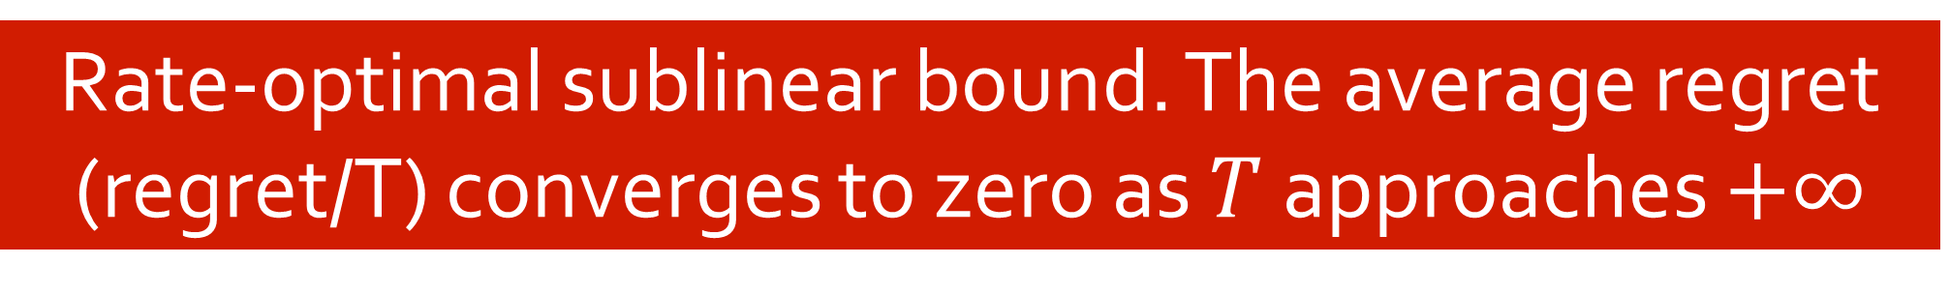
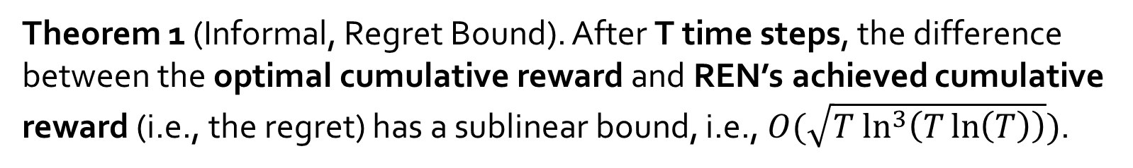
22
Theoretical Analysis
Lemma 1 (Informal, Confidence Bound). For a user at time $t$, the difference between REN’s estimated reward and the true reward for item $k$ is bounded by a weighted sum of the diversity term and the uncertainty term.
Theorem 1 (Informal, Regret Bound). After T time steps, the difference between the optimal cumulative reward and REN’s achieved cumulative reward (i.e., the regret) has a sublinear bound, i.e., $O(\sqrt{T ln^{3}\left(T\ln\left(T\right)\right)})$.
Rate-optimal sublinear bound. The average regret (regret/T) converges to zero as $T$ approaches $+∞$
Notes:
Lemma 1 (Informal, Confidence Bound). For a user at time $t$, the difference between the estimated reward for item $k$ (i.e., ${\hat{r}}_{t,k}$) and the true reward (i.e., ${x_{t,k}^{∗}}^{T}θ^{∗}$)

Slide 23
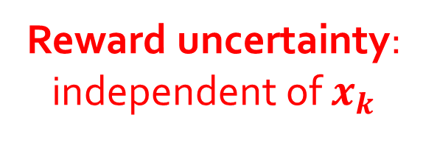
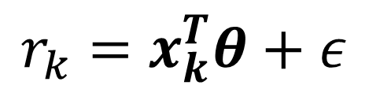
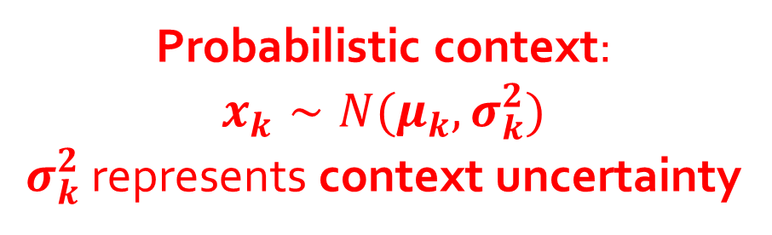
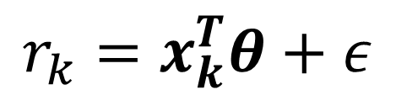

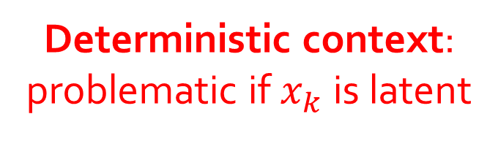
Reward Uncertainty versus Context Uncertainty
23
Reward Uncertainty in Typical Contextual Bandits:
$$r_{k}=x_{k}^{T}θ+ε$$
Deterministic context:
problematic if $x_{k}$ is latent
Reward uncertainty: independent of $x_{k}$
$$r_{k}=x_{k}^{T}θ+ε$$
Context Uncertainty in Our REN:
Probabilistic context:
$$x_{k}∼N(μ_{k},σ_{k}^{2})$$
$σ_{k}^{2}$ represents context uncertainty
Reward uncertainty: independent of $x_{k}$

Slide 24
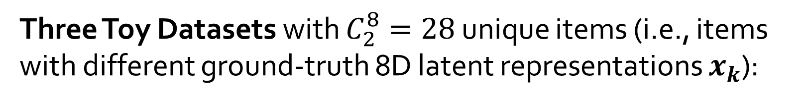
Toy Datasets and Simulated Environment
24
Three Toy Datasets with $C_{2}^{8}=28$ unique items (i.e., items with different ground-truth 8D latent representations $x_{k}$):
SYN-S: 15 users, 28 items
SYN-M: 15 users, 28*10=280 items
SYN-L: 15 users, 28*100=2800 items
Simulated Environment:
At each time step t,
randomly choose one user,
ask the model to recommend 4 items, and
return the reward

Slide 25
Baselines (Base Models)
25
Focus on sequential base models
  GRU4Rec: Gated recurrent units for session-based recommendation
  TCN: Temporal convolutional networks for sequential recommendation
  HRNN: Hierarchical recurrent neural networks for sequential recommendation

Slide 26
Toy Dataset: SYN-S
26
REN-G (GRU4Rec w/ REN)
REN-T (TCN w/ REN)
REN-H (HRNN w/ REN)
GRU4Rec
TCN
HRNN
Our REN can use any base models and improve long-term rewards

Slide 27
Toy Dataset: SYN-S
27
REN-H (HRNN w/ REN)
HRNN
Our REN can use any base models and improve long-term rewards

Slide 28
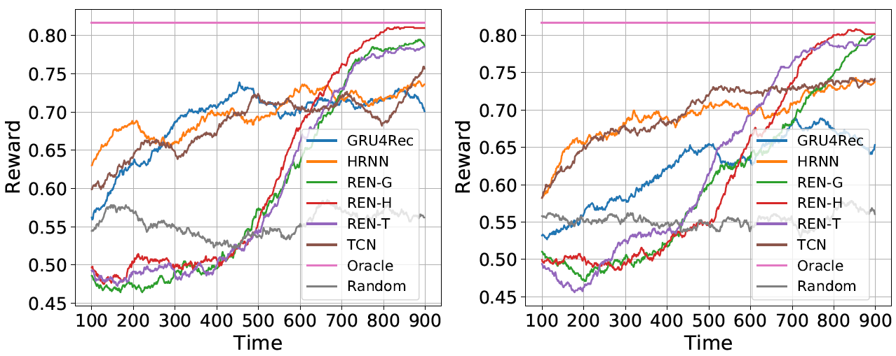
Toy Dataset: SYN-M and SYN-L
28
Similar improvements in SYN-M and SYN-L

Slide 29
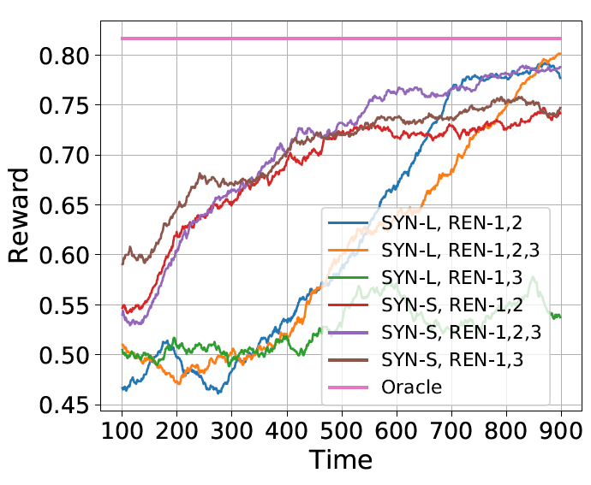
Ablation Study: Diversity Term and Uncertainty Term
29
SYN-L, REN-1,2,3: w/ diversity item
SYN-L, REN-1,3: w/o diversity term
Diversity term helps effective exploration in the compact latent space when the item space is large (e.g., 2800 items)

Slide 30
Ablation Study: Diversity Term and Uncertainty Term
30
SYN-L, REN-1,2,3: w/ uncertainty item
SYN-L, REN-1,2: w/o uncertainty term

Slide 31
Ablation Study: Diversity Term and Uncertainty Term
31
SYN-S, REN-1,2,3: w/ uncertainty item
SYN-S, REN-1,2: w/o uncertainty term
Uncertainty term helps explore uncertain items and pushes long-term rewards closer to the optimum (oracle)

Slide 32
Evaluation on Real-World Datasets
32
Three Recommender System Datasets
MovieLens-1M: 6040 users, 3900 items, 1M interactions
Netflix (subset): 480K users, 17K items, 100M interactions
Trivago: 730K users, 926K items, 910K interactions

Slide 33
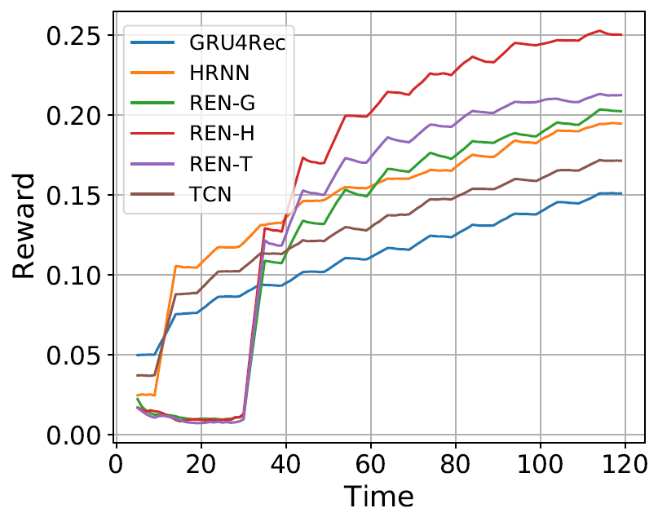
MovieLens-1M: Results
33
REN-H (HRNN w/ REN)
REN-T (TCN w/ REN)
REN-G (GRU4Rec w/ REN)
HRNN
TCN
GRU4Rec

Slide 34
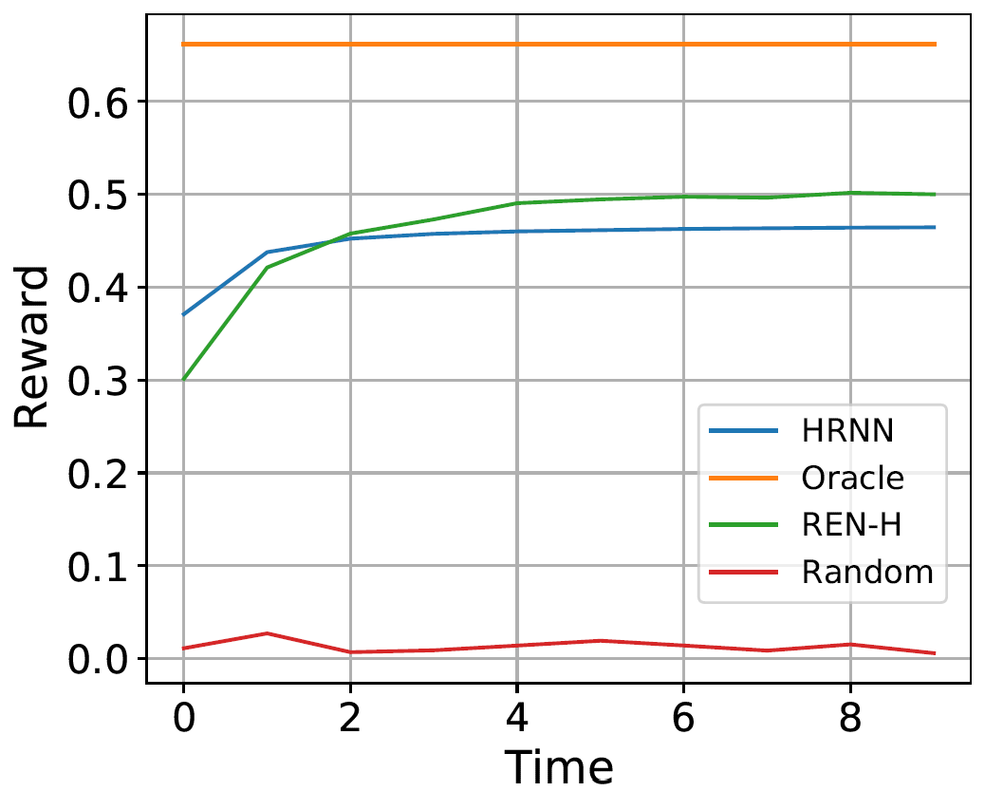
Netflix: Results
34
REN-H (HRNN w/ REN)
HRNN
Our REN performs effective exploration to achieve higher long-term reward

Slide 35
Trivago: Slightly Different Setting, Impression Data
35
MovieLens-1M and Netflix: At each time t, models recommend items from the entire item set (3900 items and 17K items)
Trivago: At each time t, models recommend items from a candidate set of 25 items that have been shown to users (i.e., impression data), instead of the entire set of 926K items

Slide 36
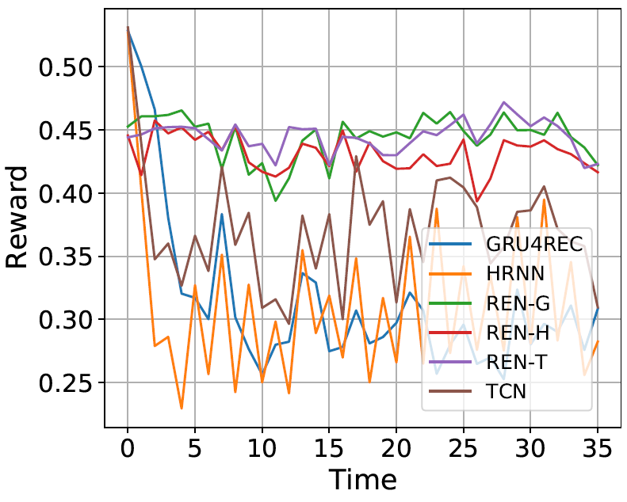
Trivago: Results
36
REN-G (GRU4Rec w/ REN)
REN-T (TCN w/ REN)
REN-H (HRNN w/ REN)
GRU4Rec
TCN
HRNN
Our REN performs effective exploration to prevent accuracy drop (maintain high accuracy)

Slide 37
Summary
37
Identify a chicken-and-egg problem when exploring in the latent space.
Framework of context uncertainty (e.g., REN) that handle this problem.
Theoretical guarantees that REN achieves the rate-optimal regret bound.
State-of-the-art performance on both synthetic and real-world RecSys datasets.
More details at http://wanghao.in/paper/AAAI22_REN.pdf.

