Slide 1
A Unified Approach to Domain Incremental Learning with Memory: Theory and Algorithm
Haizhou Shi, Hao Wang
Computer Science Department, Rutgers University
Notes:
Hello everyone, I’m Haizhou Shi. It is my pleasure to be here at the conference of NeurIPS 2023, presenting our recent study “A Unified Approach to Domain Incremental Learning with Memory: Theory and Algorithm”. This is joint work with my Ph.D. advisor Prof. Hao Wang in the CS department at Rutgers University.

Slide 2
Background
Domain Incremental Learning (DIL)
Machine learning models are required to incrementally learn the evolving data distributions.
E.g., autonomous driving under different weather conditions.
Memory constraint: no (or very limited size of) the past data can be stored during training.
$$D_{1}$$
$$D_{2}$$
$$D_{1}$$
$$D_{2}$$
...
$$D_{t}$$
...
$$D_{t}$$
Current Domain Learning
Sample Selection
Current Domain Learning
Continual Learner
Memory
Continual Learner
Previous Domains
(Unavailable)
Sample Replay
Notes:
In domain incremental learning, machine learning algorithms need to incrementally learn from the evolving data distribution without forgetting the past knowledge. For instance, think of an autonomous driving system that is designed to adapt to new weather conditions without forgetting the lessons from previous scenarios. The key challenge is to avoid the trivial and resource-intensive solutions such as storing all the past data and re-training the model for every new domain. Hence in this case, only a small portion of or even no data should be preserved during the incremental learning stage.

Slide 3
Background
Domain Incremental Learning (DIL)
Machine learning models are required to incrementally learn the evolving data distributions.
E.g., autonomous driving under different weather conditions.
Memory constraint: no (or very limited size of) the past data can be stored during training.
Goal of DIL: minimize the model’s risk over all domains.
Notes:
In general, the goal of domain incremental learning is to minimize the risks over all the domains.

Slide 4
ERM-Based Generalization Bound
Empirical Risk Minimization (ERM) via Experience Replay (ER)
[Lemma 3.1] Trivially replaying the memory will cause a loose generalization bound.
Memory: ${ℳ=\{M_{i}\}}_{i=1}^{t−1}$
Encoder $e$
Predictor $p$
Classification Loss
$$ε_{𝒟_{i}}\left(h\right)+ε_{𝒟_{t}}(h)$$
$$t$$
Current Domain Data: $𝒮_{t}$
Current Model $h$
Domain ID
Notes:
Due to the aforementioned memory size constraint, however, trivially replaying the memory will cause a very loose generalization bound, which is due to the extreme data imbalance in this case. Several empirical techniques have been proposed for DIL, including Dark Experience Replay and Learning without Forgetting.

Slide 5
Intra-Domain Model-Based Bound
Dark Experience Replay (DER++)
[Lemma 3.2] Intra-Domain Model-Based Bound
Distillation Loss
$$ε_{𝒟_{i}}(h,H_{t−1})$$
History Model $H_{t−1}$
Memory: ${ℳ=\{M_{i}\}}_{i=1}^{t−1}$
Encoder $e$
Predictor $p$
Classification Loss
$$ε_{𝒟_{i}}\left(h\right)+ε_{𝒟_{t}}(h)$$
$$t$$
Current Domain Data: $𝒮_{t}$
Current Model $h$
Domain ID
Notes:
In Dark Experience Replay, in addition to the classification losses, the distillation loss between the current model h and the history model H_{t-1} is calculated on the memory data. We theoretically justify this empirical loss by introducing the intra-domain model-based bound in Lemma 3.2, which indicates that this loss should be optimized only when the history model’s error is small.

Slide 6
Cross-Domain Model-Based Bound
Learning without Forgetting (LwF)
[Lemma 3.3] Cross-Domain Model-Based Bound
History Model $H_{t−1}$
Distillation Loss $ε_{𝒟_{t}}(h,H_{t−1})$
Encoder $e$
Predictor $p$
Classification Loss
$$ε_{𝒟_{t}}(h)$$
$$t$$
Current Domain Data: $𝒮_{t}$
Current Model $h$
Domain ID
Notes:
In Learning without Forgetting, due to the strict memory constraint, the distillation loss can only be calculated on the current-domain dataset. Our Lemma 3.3 provides the theoretical justification for this cross-domain distillation loss, when the H-delta-H divergence between two domains is small enough to be neglected.

Slide 7
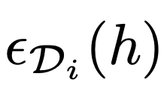
UDIL: A Unified Bound for DIL
A set of coefficients integrates them into one unified bound.
[Theorem 3.4] Unified Generalization Bound for all domains
Naïve ERM
Intra-Domain Bound
Cross-Domain Bound
Notes:
Based on that, we introduce a set of coefficients, alpha, beta, and gamma to weigh different loss terms, which includes three ways of upper-bounding the domain-specific error epsilon Di of (h). By re-organizing the original domain incremental learning objective, we have a unified generalization bound for all domains. It is dubbed as UDIL stated in Theorem 3.4, which is the main contribution of this study.

Slide 8
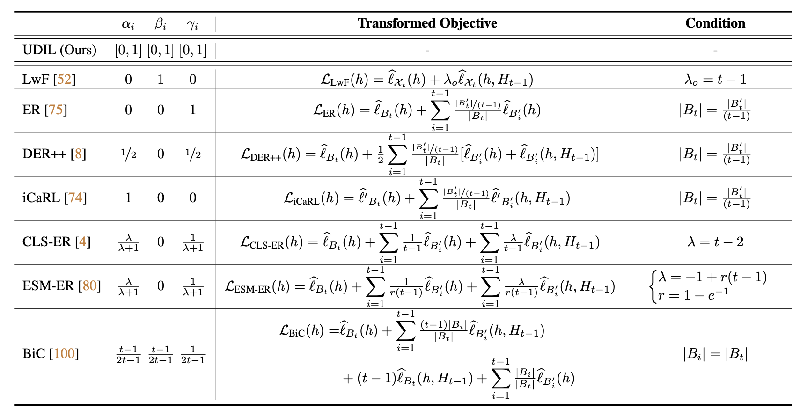
UDIL: A Unified Bound for DIL
UDIL unifies multiple existing methods under certain conditions.
Notes:
The first key insight brought by our analysis is that multiple existing methods are unified under this theoretical framework. When certain conditions are satisfied, methods like Experience Replay, Learning without Forgetting, Dark Experience Replay, iCaRL, and etc. correspond to a fixed set of the coefficients in the family of bounds defined by UDIL.

Slide 9
UDIL: An Adaptive Bound for DIL
UDIL can adaptively adjust the coefficients based on the data and the history model $H_{t−1}$.
It will, ideally, minimize the tightest bound in the family of all the generalization bounds.
$ε_{𝒟_{i}}(h,H_{t−1})$, $ε_{𝒟_{t}}(h,H_{t−1})$
History Model $H_{t−1}$
$${ℳ=\{M_{i}\}}_{i=1}^{t−1}$$
Predictor $p$
$ε_{𝒟_{i}}(h)$, $ε_{𝒟_{t}}(h)$
$$t$$
Encoder $e$
$$𝒮_{t}$$
Discriminator $d$
$$V_{d}(d,e)$$
$$Ω={\{α_{i},β_{i},γ_{i}\}}_{i=1}^{t−1}$$
Domain ID
Notes:
The second insight of UDIL is that now we can adaptively adjust the coefficients so that we can minimize the tightest bound, which comprises the main algorithm proposed in our paper. To achieve this, we need to translate each term in the generalization bound to a differentiable loss.

Slide 10
UDIL: An Adaptive Bound for DIL
History Model $H_{t−1}$
$${ℳ=\{M_{i}\}}_{i=1}^{t−1}$$
Predictor $p$
Cross-Entropy Classification Loss
$$t$$
Encoder $e$
$$𝒮_{t}$$
Discriminator $d$
Domain ID
Notes:
For each ERM term colored in blue, we use the standard cross-entropy classification loss term, which affects the encoder and the predictor of the current model.

Slide 11
UDIL: An Adaptive Bound for DIL
History Model $H_{t−1}$
Cross-Entropy Distillation Loss
$${ℳ=\{M_{i}\}}_{i=1}^{t−1}$$
Predictor $p$
$$t$$
Encoder $e$
$$𝒮_{t}$$
Discriminator $d$
Domain ID
Notes:
For each intra-domain and cross-domain error term colored in green, we use the cross-entropy distillation loss, with the history model H_{t-1} as the teacher network and h as the student network.

Slide 12
UDIL: An Adaptive Bound for DIL
History Model $H_{t−1}$
$${ℳ=\{M_{i}\}}_{i=1}^{t−1}$$
Predictor $p$
$$t$$
Encoder $e$
$$𝒮_{t}$$
Discriminator $d$
Adversarial Feature Alignment Loss
Domain ID
Notes:
For the H-delta-H divergence term in the upper bound, inspired by the domain adaptation theory, we propose to introduce a discriminator and adversarially align the feature embedding distributions among different domains.

Slide 13
UDIL: An Adaptive Bound for DIL
History Model $H_{t−1}$
$$Ω={\{α_{i},β_{i},γ_{i}\}}_{i=1}^{t−1}$$
$${ℳ=\{M_{i}\}}_{i=1}^{t−1}$$
Predictor $p$
Encoder $e$
Adaptive Coefficient Optimization
$$t$$
$$𝒮_{t}$$
Discriminator $d$
Domain ID
Notes:
For the remaining part of the objective, we treat them as constant to be estimated during optimization or a hyper-parameter.

Slide 14
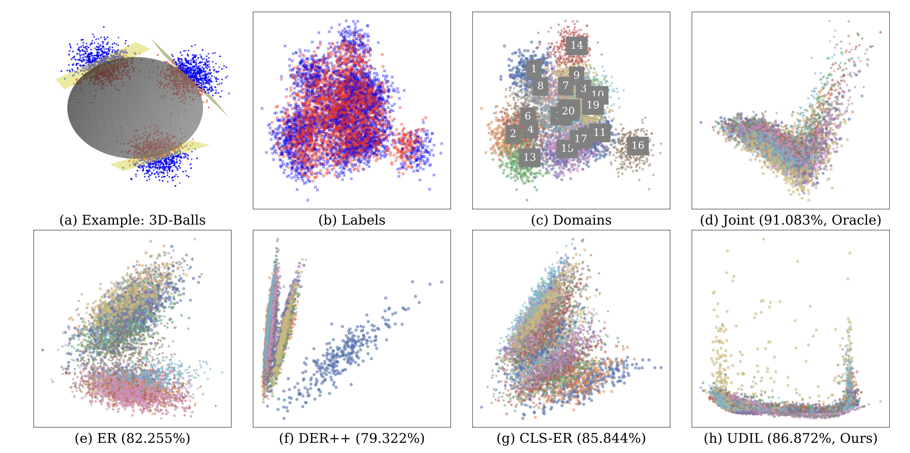
UDIL: Experimental Results
UDIL’s representation distribution on synthetic dataset (high-dimensional balls)
Notes:
We validate the effectiveness of adaptively minimizing the UDIL’s learning objective under multiple settings. In the synthetic dataset high-dimensional balls, each domain is a gaussian distribution that is separated by a hyperplane. We visualize each methods’ representation distributions after the encoder. As shown in the figure, the oracle model joint training achieves natural domain alignment, and achieves the optimal performance as well. Our method UDIL, compared to other baselines, achieves the feature alignment across domains, and therefore outperforms them by a large margin.

Slide 15
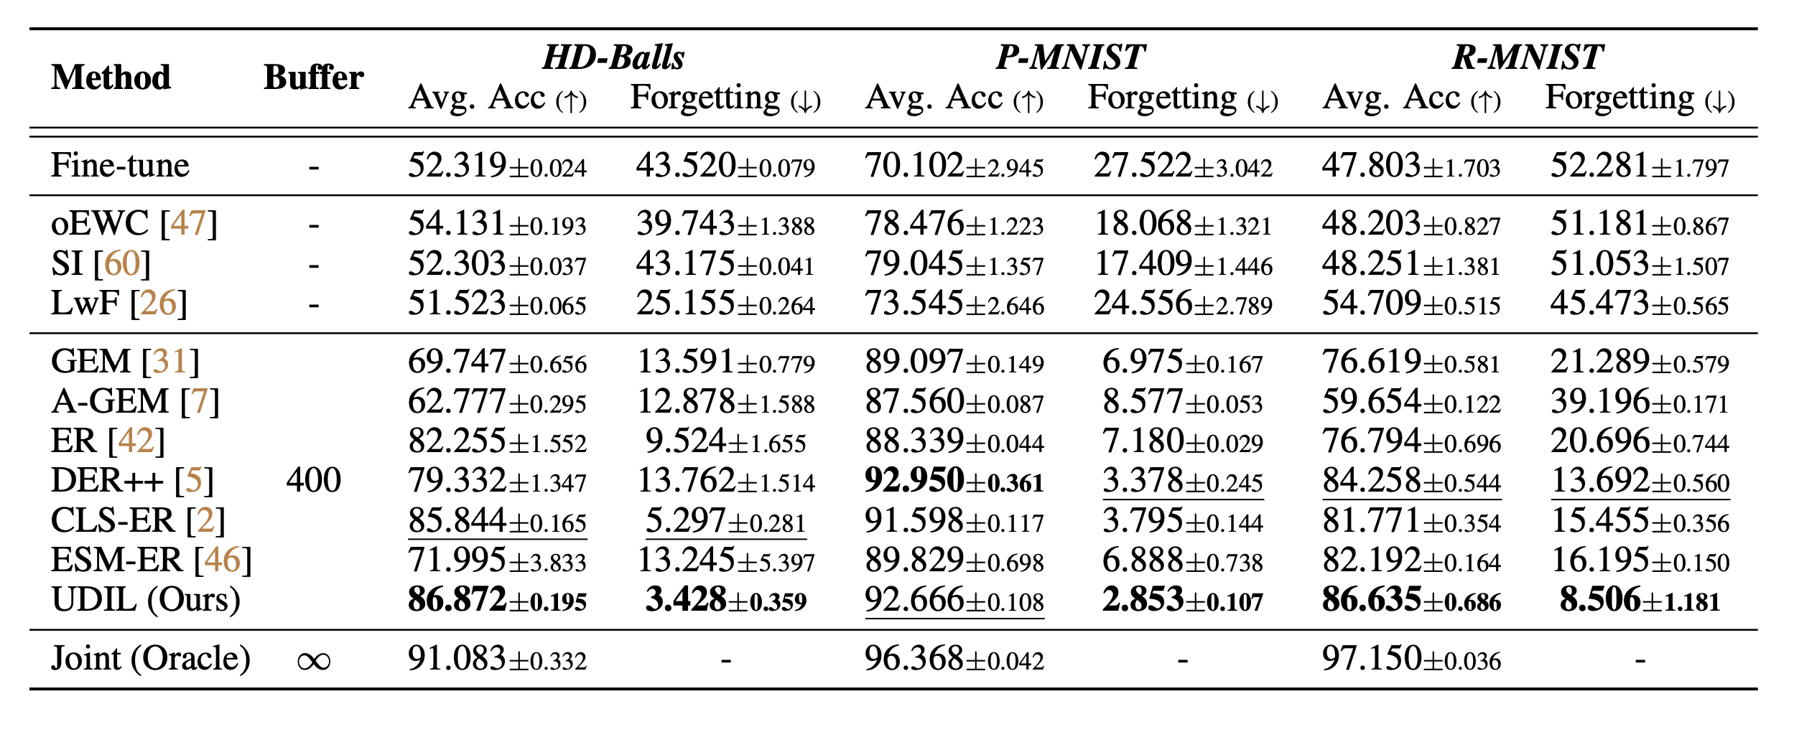
UDIL: Experimental Results
UDIL evaluated on realistic datasets.
HD-Balls, Permuted-MNIST, Rotated-MNIST
Notes:
We further benchmark our method and other baselines on three realistic datasets including Permuted-MNIST, Rotated-MNIST, and Sequential CORe-50. The proposed framework UDIL outperforms the state-of-the-art domain incremental learning methods consistently, which showcases the effectiveness of the core idea of adaptively minimizing the tightest generalization bound.

Slide 16
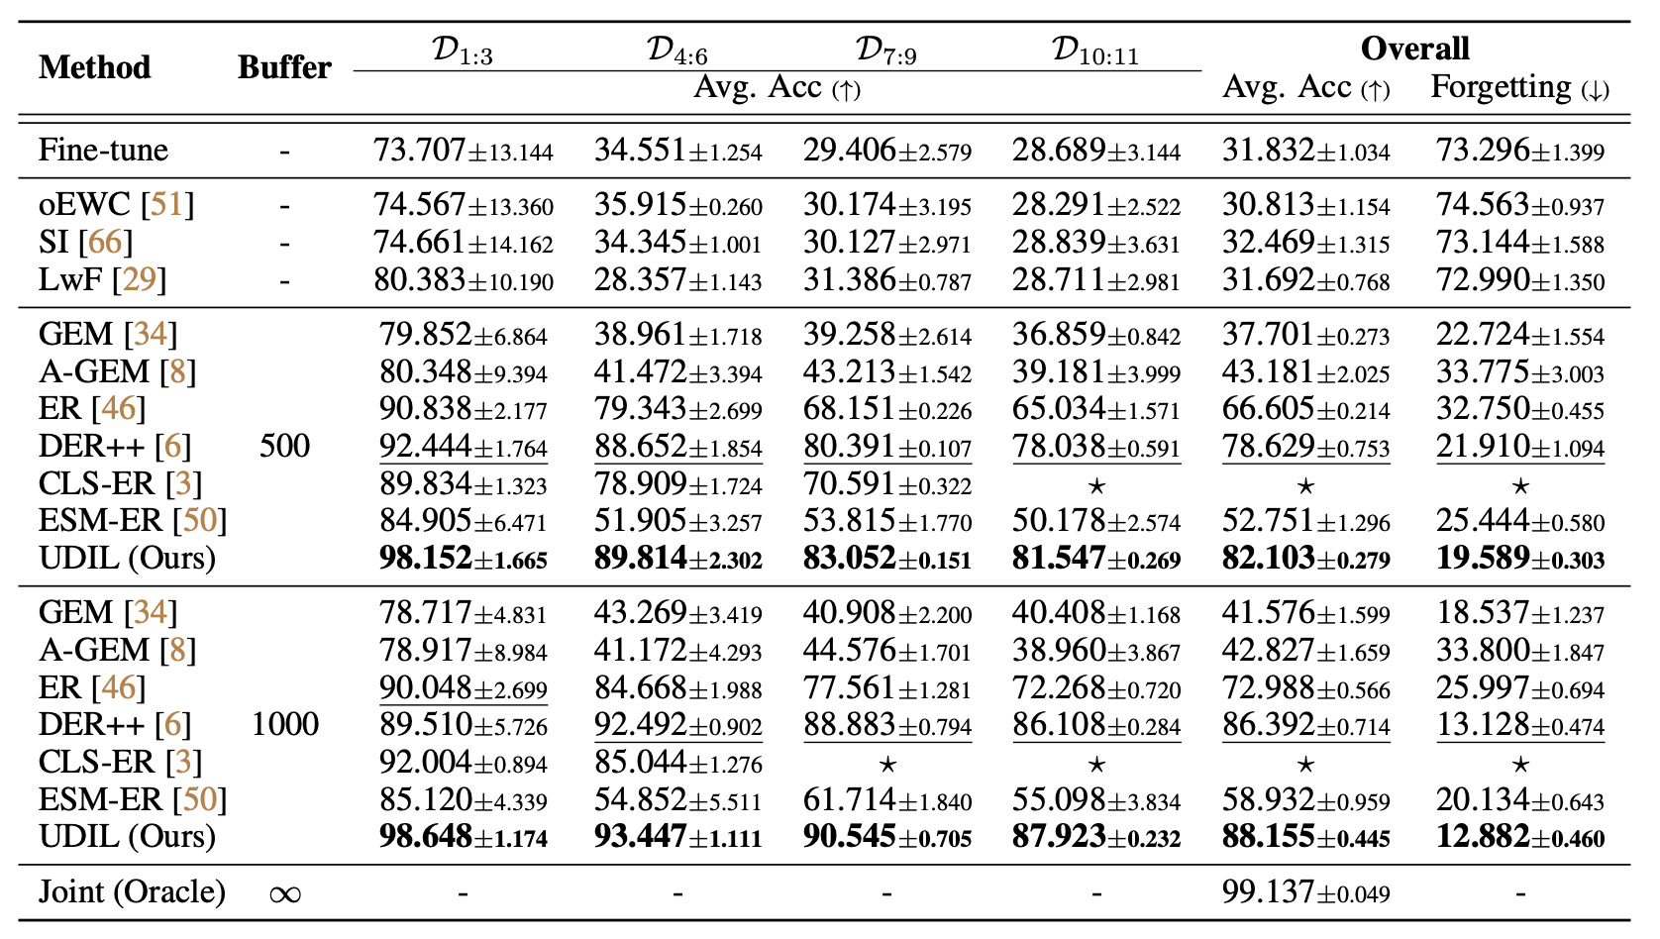
UDIL: Experimental Results
UDIL evaluated on realistic datasets.
Sequential CORe-50
Notes:
We further benchmark our method and other baselines on three realistic datasets including Permuted-MNIST, Rotated-MNIST, and Sequential CORe-50. The proposed framework UDIL outperforms the state-of-the-art domain incremental learning methods consistently, which showcases the effectiveness of the core idea of adaptively minimizing the tightest generalization bound.

Slide 17
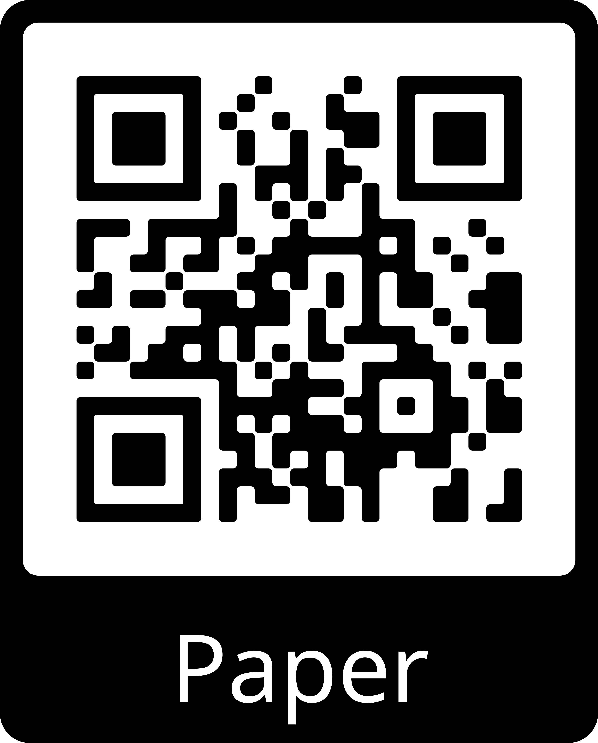
Conclusion
Proposed a principled framework, UDIL, for domain incremental learning with memory to unify various existing methods.
Theoretical analysis shows that different existing methods are equivalent to minimizing the same error bound with different fixed coefficients.
UDIL allows adaptive coefficients during training, thereby always achieving the tightest bound and improving the performance.
Notes:
In conclusion, in this paper, we proposed a principled framework for domain incremental learning that unifies various existing methods. Theoretical analysis shows that different existing methods are equivalent to minimizing the same error bound with different fixed coefficients. UDIL allows adaptive coefficients during training, thereby always achieving the tightest bound and improving the performance.
For more information, please check out our full paper and the source code by using the following QR codes.

