Slide 1





Variational Imbalanced Regression:
Fair Uncertainty Quantification via Probabilistic Smoothing
Ziyan Wang, Hao Wang
Notes:
Hello everyone, today we are going to present our paper: Variational imbalanced regression.

Slide 2
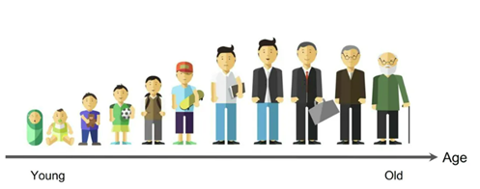
Motivation
Low error & High uncertainty
Low error & Low uncertainty
High error & Low uncertainty
1
1
1
1
1
1
Uncertainty Quantification
Prediction
Ground-Truth
0
0
0
0
0
0
Underconfident
Overconfident
Age Distribution
0
100
Notes:
Here is our motivation. Suppose we have a human dataset, and features are representing various physiological data, and output is a continuous value indicating the side effects experienced from certain drugs.
The yellow line here is the age distribution for this dataset. Note that the dataset is imbalanced, with a substantial number of samples in the 25-45 age range, while data on infants and the elderly are sparse.
Now, in such scenario, a deep regression model is trained, and we are likely to encounter three cases.
For the age groups with ample data, such as those between 25-45, the model is expected to yield low error with low uncertainty, which is perfect and what we expected.
For the age groups that are minorities, we may either have the case that it shows low error with high uncertainty, which indicates the model is underconfident, or it shows high error with low uncertainty, which means the model is overconfident.
This example shows the importance of designing novel algorithms to make reliable predictions and uncertainty quantification when the training data is imbalanced, now I will introduce our methods.

Slide 3
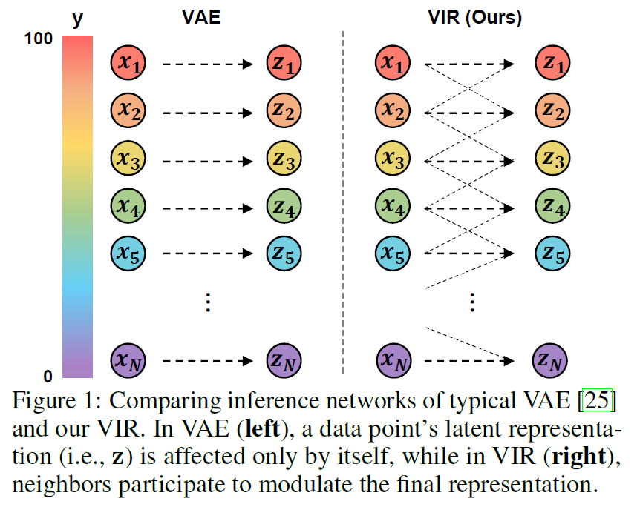

Method (Feature Space): Constructing $q\left(z_{i}\right|{\left\{x_{i}\right\}}_{i=1}^{N})$
I.I.D. vs. N.I.D. (Neighboring and Identically Distributed)
P (y)
P ($\tilde{y}$)
Notes:
Our approach introduces a novel assumption termed ‘N.I.D’ (Neighboring and Identically Distributed), which differs from the common I.I.D assumption in most deep learning models. Under the I.I.D assumption, each latent data is only influenced by its original data point. In contrast, our N.I.D. assumption asserts that each latent data is influenced not just by its own original data point, but also by neighboring data points.
As illustrated in the figure on the right, if we consider P(y) to be our latent distribution, and y is the corresponding label for each latent data. Then, after applying some kernels to smooth this distribution, then we will have a reweighted curve, and we can observe that the original minorities get enlarged, which will increase the confidence in the model predictions, that is our first method.

Slide 4

P (y)
reweighting
P ($\tilde{y}$)

Slide 5

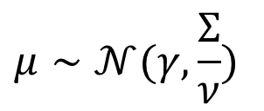








Method (Label Space): Constructing $p(y_{i}|z_{i})$
Pseudo Count
Last layer
$$γ$$
$$μ∼𝒩(γ,\frac{Σ}{ν})$$
$$n$$
Prediction
$$ν$$
$$z$$
$$Ψ$$
$$α$$
$$Φ$$
$$Σ∼Γ^{−1}(α, β)$$
Uncertainty Quantification
$$β$$
Pseudo Mean
Pseudo Covariance
Notes:
Now, given the reweighted latent feature we have, we generate the pseudo-count, pseudo-mean, and pseudo-covariance.
Next, based on these three pseudo params, we are able to calculate the posterior parameters of the NIG distribution.
In the end, we can further obtain the mean and covariance of our results, where the mu is the prediction and \Sigma is the uncertain quantification
And note that the pseudo-count will be reweighted similarly as we did in the feature space to increase the confidence for model predictions.

Slide 6







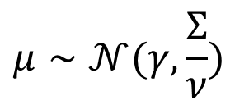


Last layer
Pseudo Count
$$γ$$
$$μ∼𝒩(γ,\frac{Σ}{ν})$$
$$n$$
$$ν$$
$$z$$
$$Ψ$$
$$α$$
$$Φ$$
$$Σ∼Γ^{−1}(α, β)$$
$$β$$
Pseudo Mean
Pseudo Covariance

Slide 7
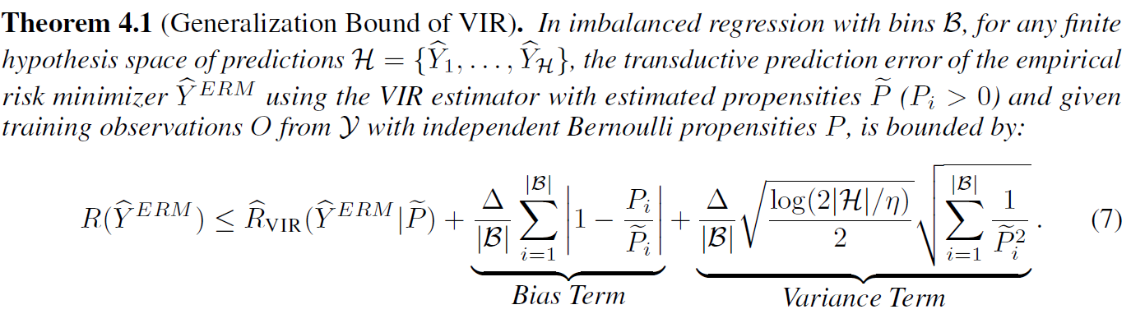
Theorem: Generalization Bound
Increase Bias;
Significantly reduce Variance in the imbalanced setting;
Lower Generalization Error.
Notes:
We also showed a generalization bound, and proved that
After reweighting original propensity P to P tidle by using our VIR estimator,
although it will increase bias, but significantly reduces its variance in the imbalanced setting, thereby leading to a lower generalization error.

Slide 8
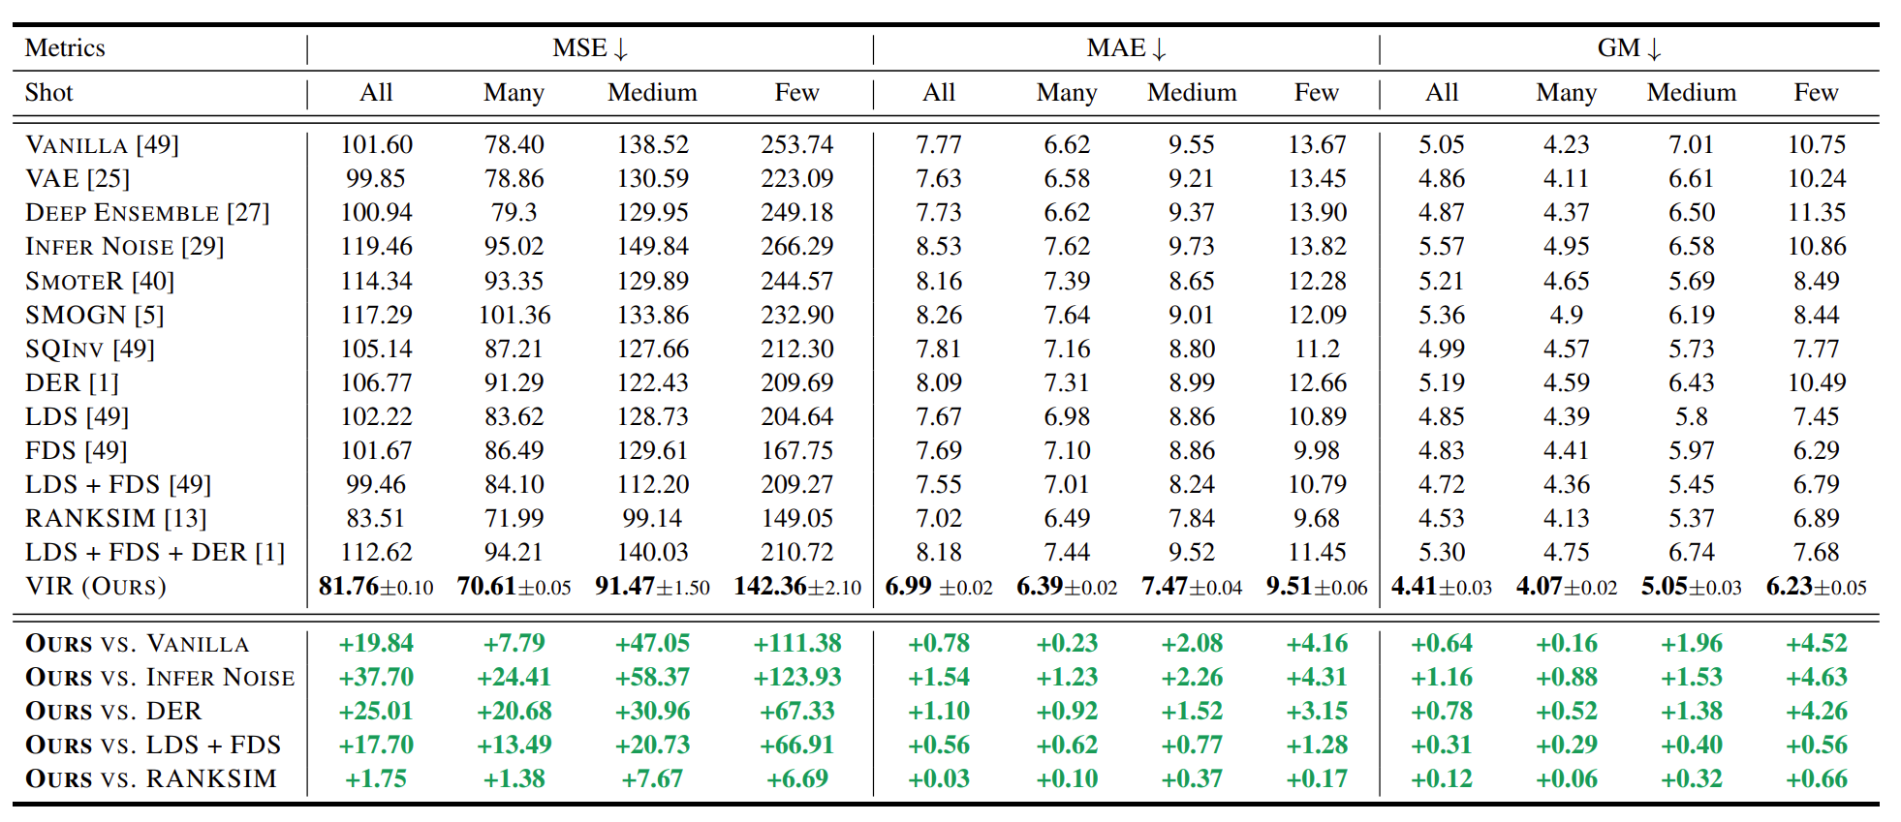
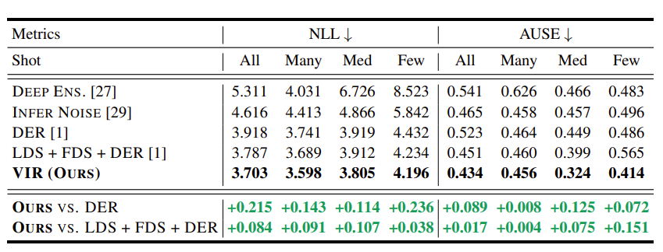
Results
Notes:
And results show that our methods outperforms all the baselines for both accuracy, and uncertainty quantification.

Slide 9
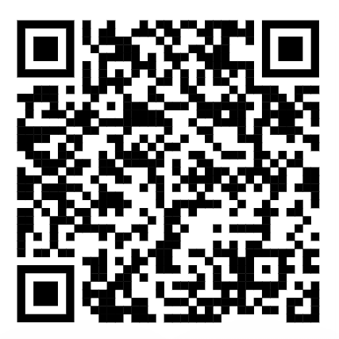
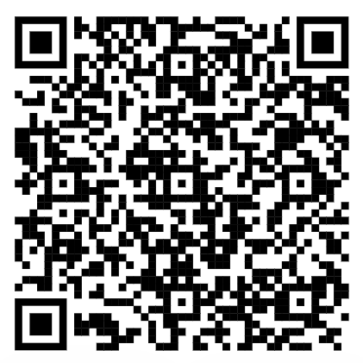
Identify the problem of probabilistic deep imbalanced regression.
Propose VIR to simultaneously cover two desiderata: balanced accuracy and uncertainty quantification.
Show that VIR can achieve better generalization bound.
Conclusion
Code will be soon available at
https: //github.com/Wang-ML-Lab/variational-imbalanced-regression.
Paper
Code
Notes:
强调三点，ending. Optional: Code will be available soon.

